Slide 1
Back to Business: Are AAPI Small Businesses Rebounding from COVID-19?
June 2021

Slide 2
Context for this Survey
After more than one year of lockdowns, devastating illness, and social unrest, there are signs that across the country customers are returning, and we’re getting back to business.
Yet there are gaps in understanding what small business owners are experiencing and whether this emerging recovery is evenly distributed within the AAPI and other small business communities
National ACE and Reimagine Main Street fielded a national survey of AAPI small business owners from April 28-June 8, 2021. In tandem, we fielded a survey including Black, Hispanic, Native and White business owners for comparison from April 28-May 12.

Slide 3
Mission: to serve as a strong advocate of AAPI business interests and affect positive change on all issues that enhance and advance the goals and aspirations of AAPI business owners.
There are 2.2 Million of Asian American & Pacific Islander (AAPI) business owners
ACE was the only national AAPI Chamber who received a CARES ACT grant from MBDA. Conducted 100+ virtual events to help AAPI businesses navigate the Covid-19 pandemic. Partnered with our network of 65+ affiliate AAPI Chambers and organizations to share resources and information nationwide.
ACE NextGen elevates the success of AAPI millennial entrepreneurs. We developed virtual programming to help AAPI business owners remain resilient during this pandemic.

Slide 4
Small businesses and their workers must rebound from the COVID-19 crisis so that communities thrive and the benefits ripple throughout the economy. We are a multi-stakeholder, cross-sector initiative focused on advancing and uplifting innovative solutions to ensure that Main Street is at the center of our recovery.
Reimagine Main Street is a project of the Public Private Strategies Institute.
Notes:
Rhett

Slide 5
AAPI Sample Overview
n = 165
Female
83
Male
82
Source: RMS/PPS/USBC/USHCC/National ACE survey, “Looking Ahead: Is Your Business Rebounding from COVID-19?” (April-May 2021)
Q31: How would you describe your race or ethnicity?
Notes:
Source: PPS Small Business Survey in partnership with National ACE, US Black Chambers, and US Hispanic Chamber of Commerce (October -November 2020)
Qx: Source: PPS Small Business Survey in partnership with National ACE, US Black Chambers, and US Hispanic Chamber of Commerce (October -November 2020)
Qx:

Slide 6
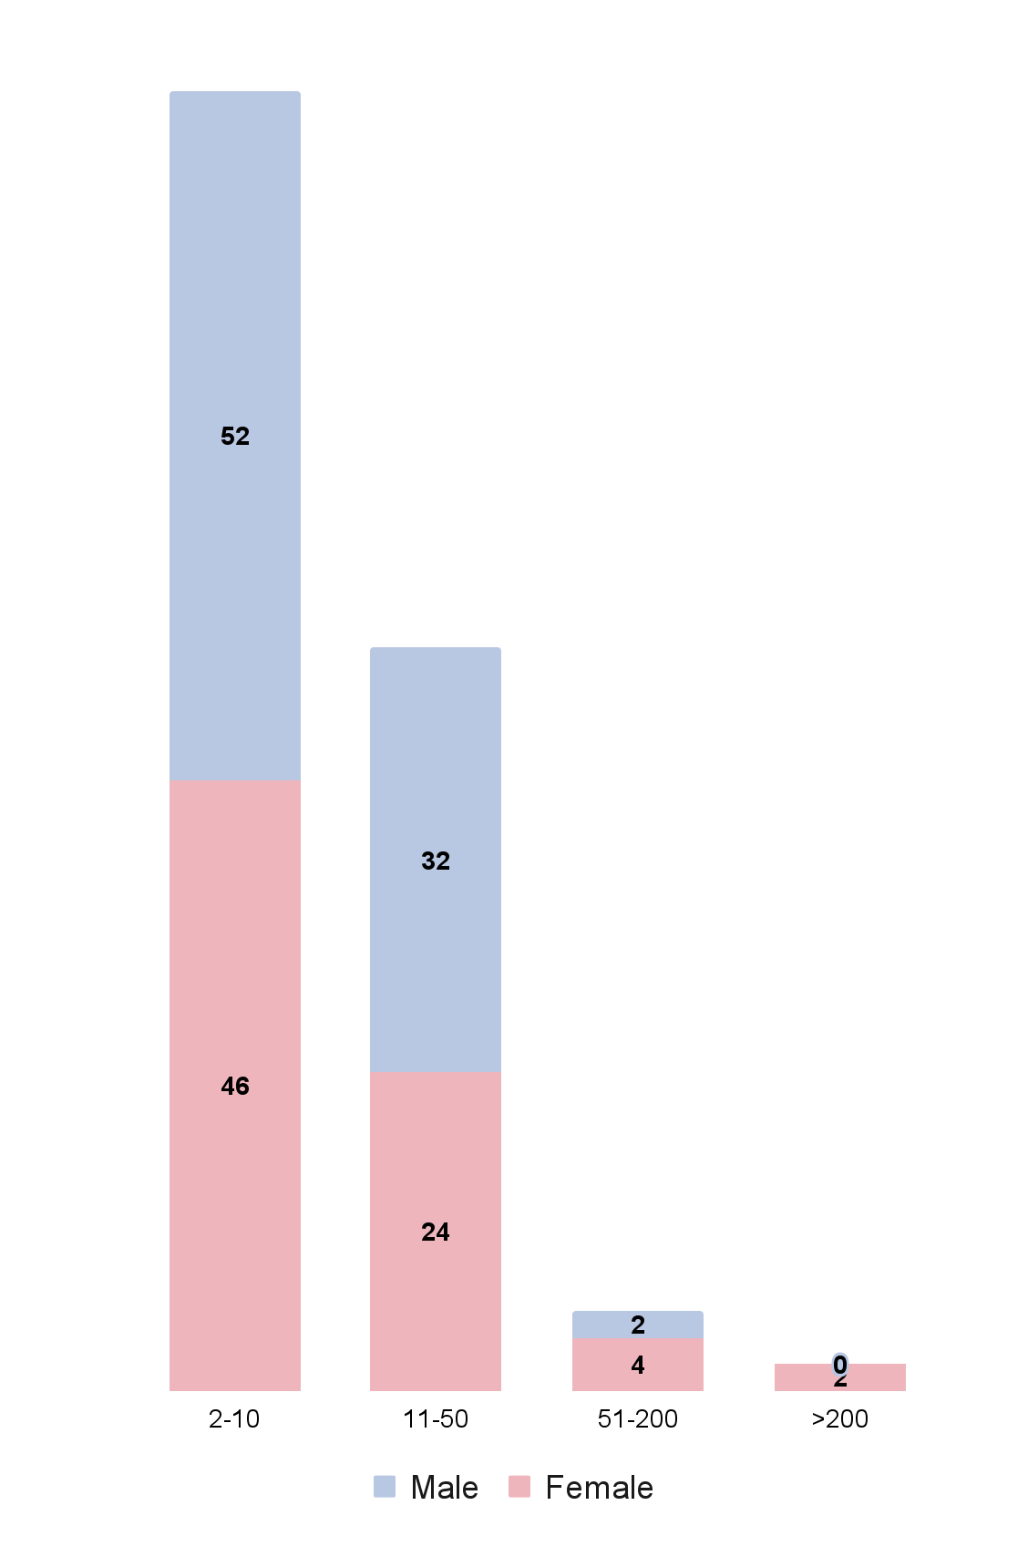
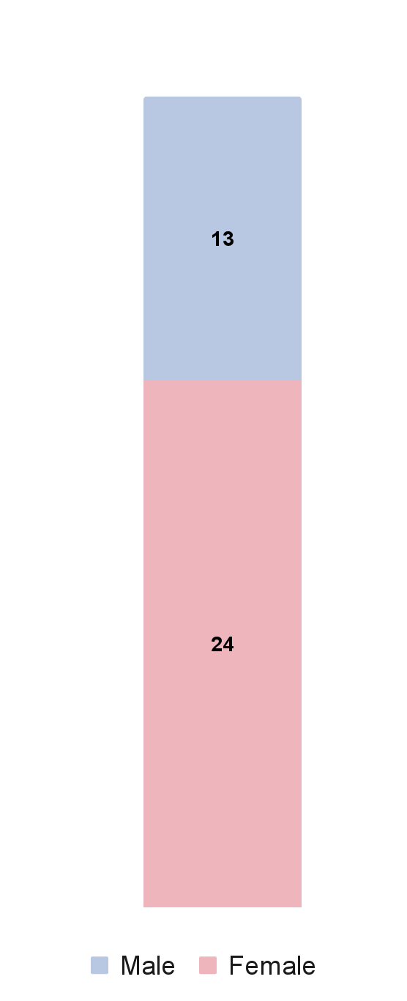
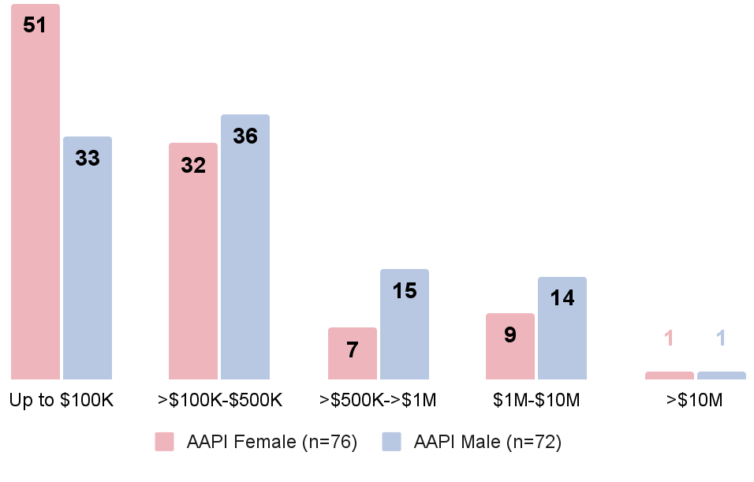
Mix of Solo, Micro and Small Businesses
Distribution by Number of Employees
% of respondents
n= 165
Distribution by 2020 Revenue
% of respondents
n= 148*
20%
Self
Employed
80%
Employer
Source: RMS/PPS/USBC/USHCC/National ACE survey, “Looking Ahead: Is Your Business Rebounding from COVID-19?” (April-May 2021)
Q2: How many people does your business employ, including yourself?
Q37: What was your business revenue in 2020? *Does not include 12 respondents who opted not to disclose revenue
Sums may not total 100% due to rounding

Slide 7
Takeaways
Most AAPI small business are optimistic about the future, but less optimistic than Black and Hispanic peers. This optimism is fueled in part by the availability of vaccines
In spite of this optimism, we are not out of the woods. AAPI business owners least likely to have experienced signs of recovery and expect a longer road to recovery than White or Hispanic peers.
On the policy advocacy front, AAPI business owners prioritize lower healthcare costs, corporate tax rates and simplified federal contracting opportunities.

Slide 8
Outlook
Notes:
Rhett

Slide 9
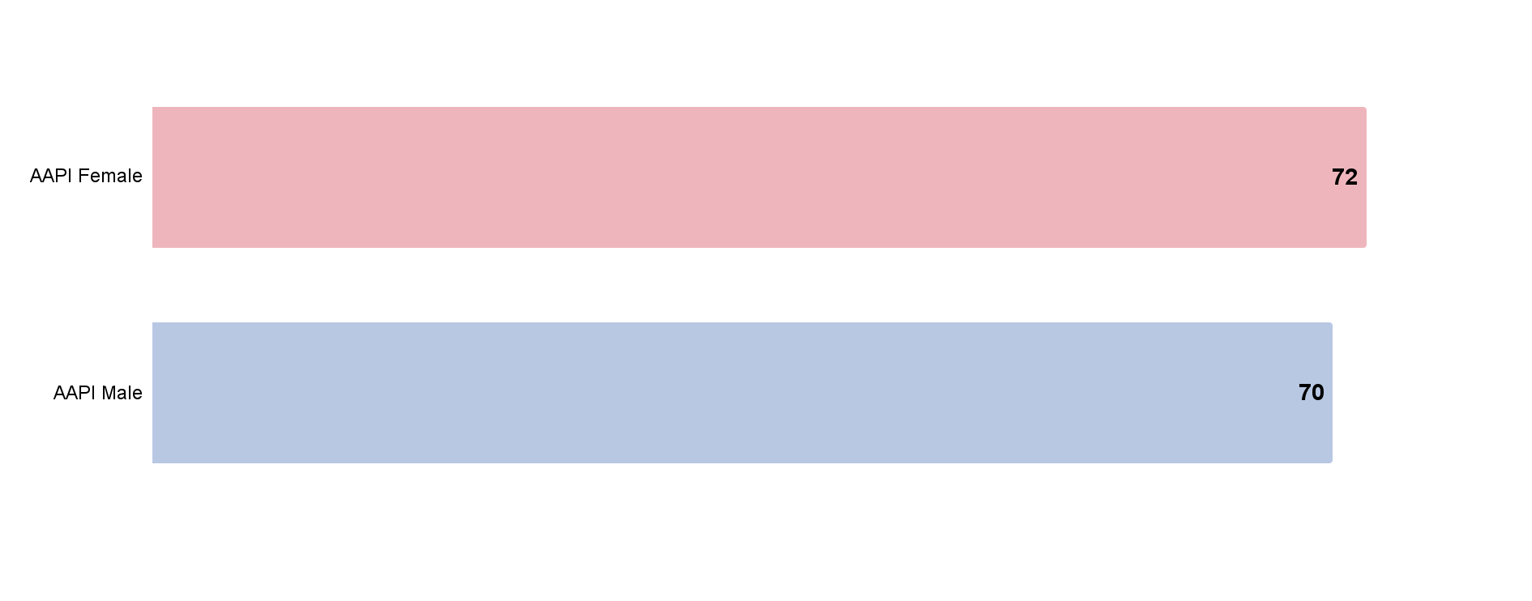
AAPI Small Business Owners are Generally Optimistic About Their Futures
Respondents who agree with statement “I am optimistic about the future of my business.”
% of Respondents*
Source: RMS/PPS/USBC/USHCC/National ACE survey, “Looking Ahead: Is Your Business Rebounding from COVID-19?” (April-May 2021)
Q4:As you reflect on where things stand today, how would you characterize your outlook:
“Strongly agree” and “agree” vs “Disagree and Strongly Disagree ; *Of those who expressed an opinion

Slide 10
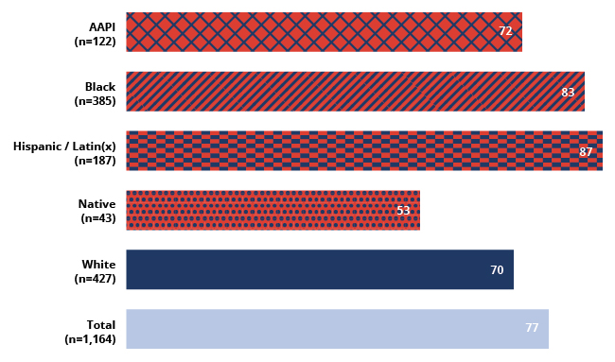
AAPI Business Owners Less Optimistic than Black & Hispanic Peers)
Respondents who agree that “I am optimistic about the future of my business.”
% of Respondents*
Source: RMS/PPS/USBC/USHCC/National ACE survey, “Looking Ahead: Is Your Business Rebounding from COVID-19?” (April-May 2021)
Q4:As you reflect on where things stand today, how would you characterize your outlook:
“Strongly agree” and “agree” vs “Disagree and Strongly Disagree ; *Of those who expressed an opinion

Slide 11
Availability of Vaccines Drives AAPI Small Business Confidence
Respondents who agree that “Seeing the availability of and access to vaccines makes me more confident in the future of my business”
% of Respondents*
Source: RMS/PPS/USBC/USHCC/National ACE survey, “Looking Ahead: Is Your Business Rebounding from COVID-19?” (April-May 2021)
Q3: Tell us the extent to which you agree or disagree with the following statements
“Strongly agree” and “agree” vs “Disagree and Strongly Disagree ; *Of those who expressed an opinion

Slide 12
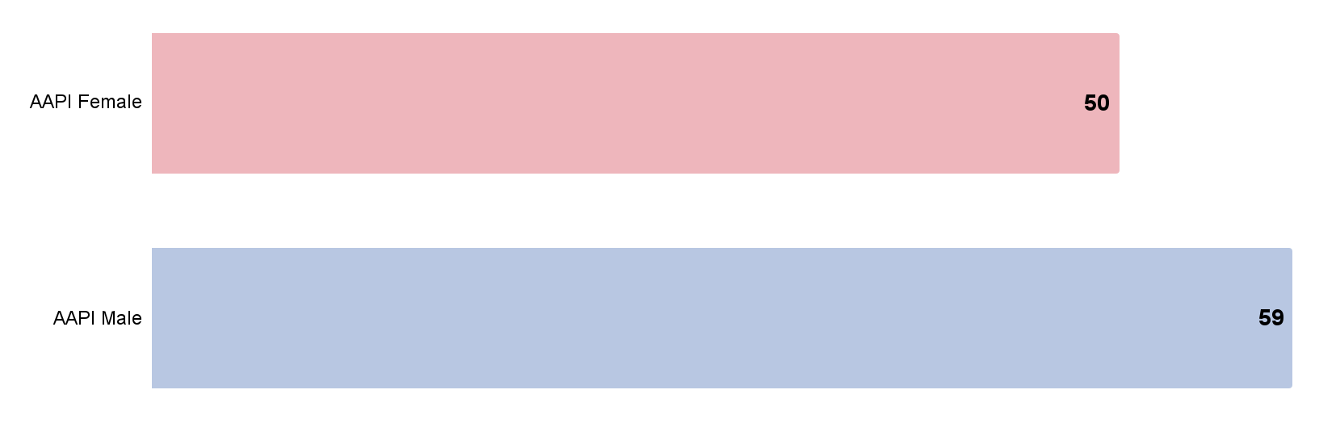
Male AAPI Business More Confident About Trajectory of Overall Economy
Respondents who agree that “I am optimistic about the current trajectory of the economy.”
% of Respondents*
Source: RMS/PPS/USBC/USHCC/National ACE survey, “Looking Ahead: Is Your Business Rebounding from COVID-19?” (April-May 2021)
Q4:As you reflect on where things stand today, how would you characterize your outlook:
“Strongly agree” and “agree” vs “Disagree and Strongly Disagree;
*Of those who expressed an opinion”

Slide 13
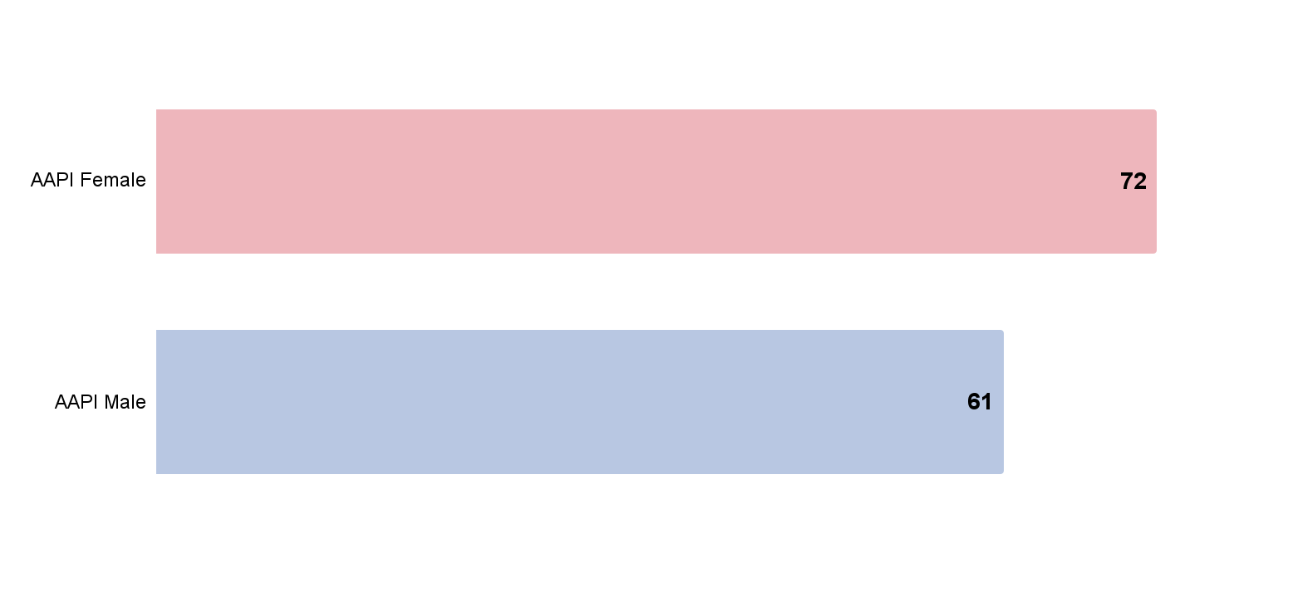
AAPI Small Business Owners Still Feeling Impact of Pandemic
Respondents who disagree with statement “We have turned the corner on the pandemic and business is returning to normal.”
% of Respondents*
Source: RMS/PPS/USBC/USHCC/National ACE survey, “Looking Ahead: Is Your Business Rebounding from COVID-19?” (April-May 2021)
Q4:As you reflect on where things stand today, how would you characterize your outlook:
“Strongly agree” and “agree” vs “Disagree and Strongly Disagree ; *Of those who expressed an opinion

Slide 14
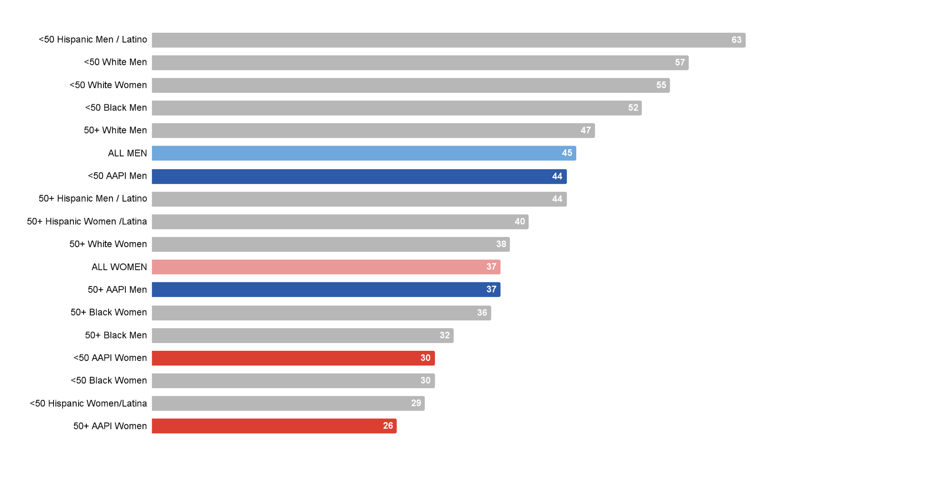
AAPI Business Owners Less Likely to Report Seeing Signs of Recovery vs Peers
“We have turned the corner on the pandemic and business is returning to normal.”
% Agree*
Source: RMS/PPS/USBC/USHCC/National ACE survey, “Looking Ahead: Is Your Business Rebounding from COVID-19?” (April-May 2021)
Q3: Tell us the extent to which you agree or disagree with the following statements
Includes Strongly Agree + Strongly Disagree
*Of those who expressed an opinion

Slide 15
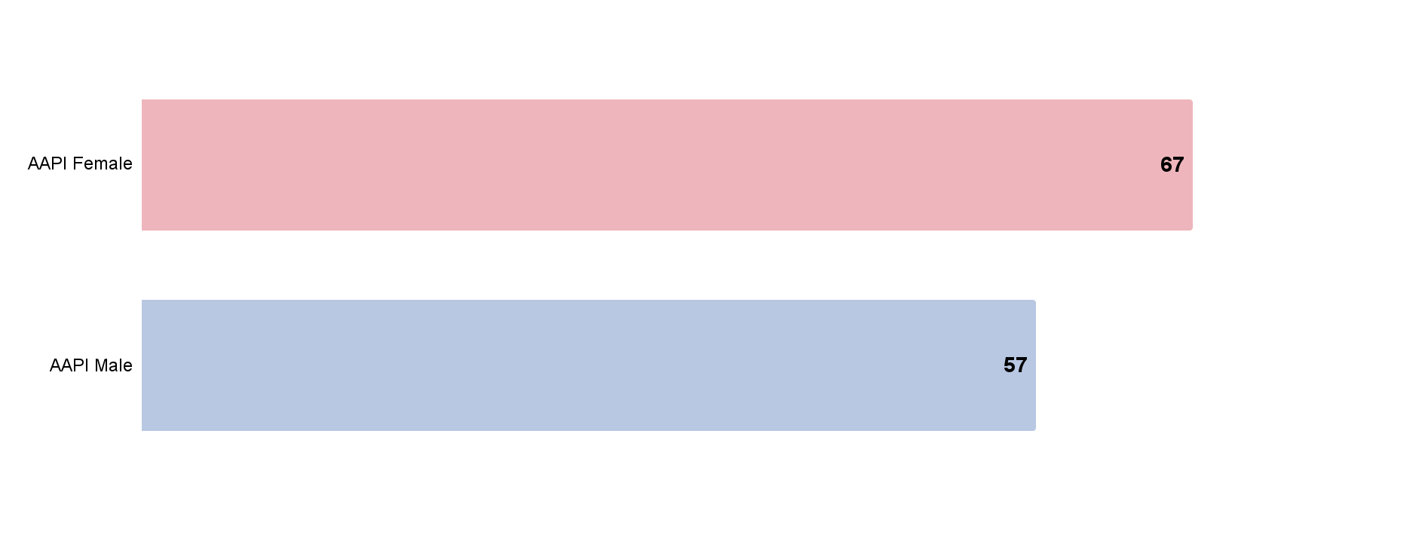
Most AAPI Small Business Owners Think It’s Not a Good Time to Be a Small Business Owner
Respondents who disagree that “It is a good time to be a small business owner in the US.”
% of Respondents
Source: RMS/PPS/USBC/USHCC/National ACE survey, “Looking Ahead: Is Your Business Rebounding from COVID-19?” (April-May 2021)
Q4:As you reflect on where things stand today, how would you characterize your outlook:
“Strongly agree” and “agree” vs “Disagree and Strongly Disagree ; Does not reflect respondents with “no opinion”

Slide 16
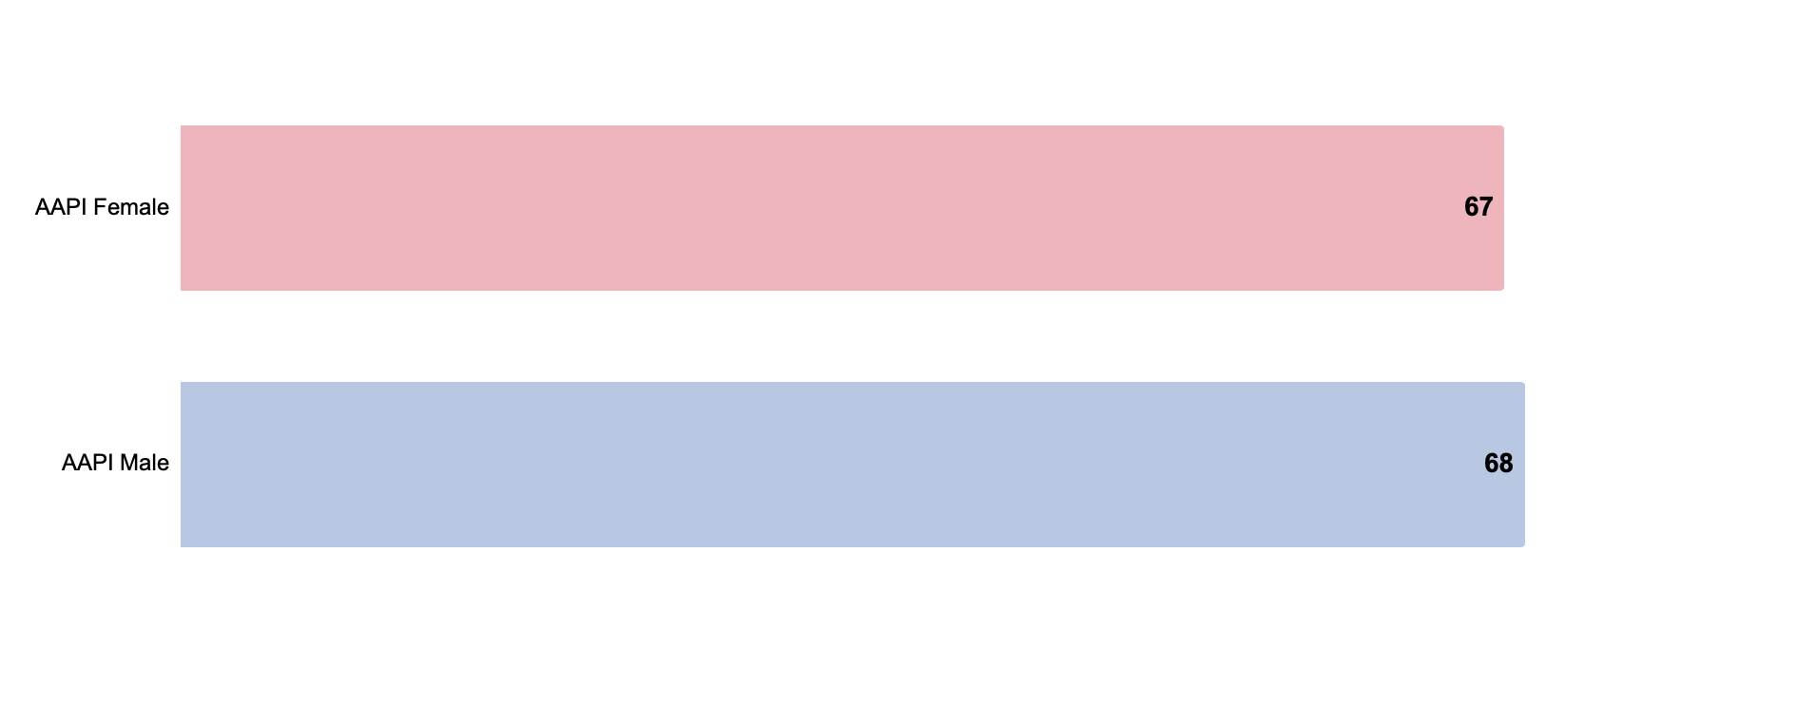
Majority of AAPI Business Owners Expect at Least 6 Months to Recovery
Expect at least 6 months before reaching pre-pandemic revenue
% of Respondents
Source: RMS/PPS/USBC/USHCC/National ACE survey, “Looking Ahead: Is Your Business Rebounding from COVID-19?” (April-May 2021)
Q5: When do you expect your business revenue to return to its pre-pandemic level?

Slide 17
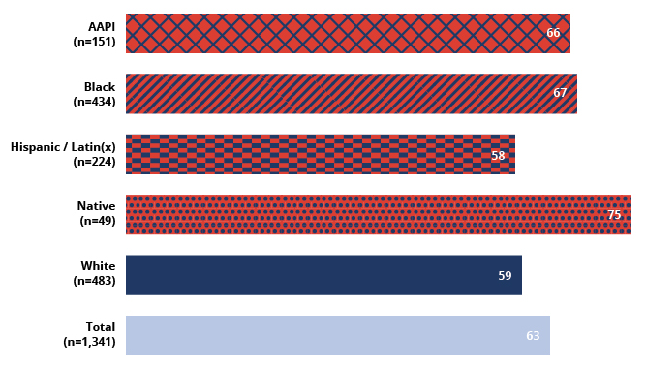
AAPI Business Owners Expect Slower Recovery vs White or Hispanic Peers
Expect at least 6 months before reaching pre-pandemic revenue
% of Respondents
Source: RMS/PPS/USBC/USHCC/National ACE survey, “Looking Ahead: Is Your Business Rebounding from COVID-19?” (April-May 2021)
Q5: When do you expect your business revenue to return to its pre-pandemic level?

Slide 18
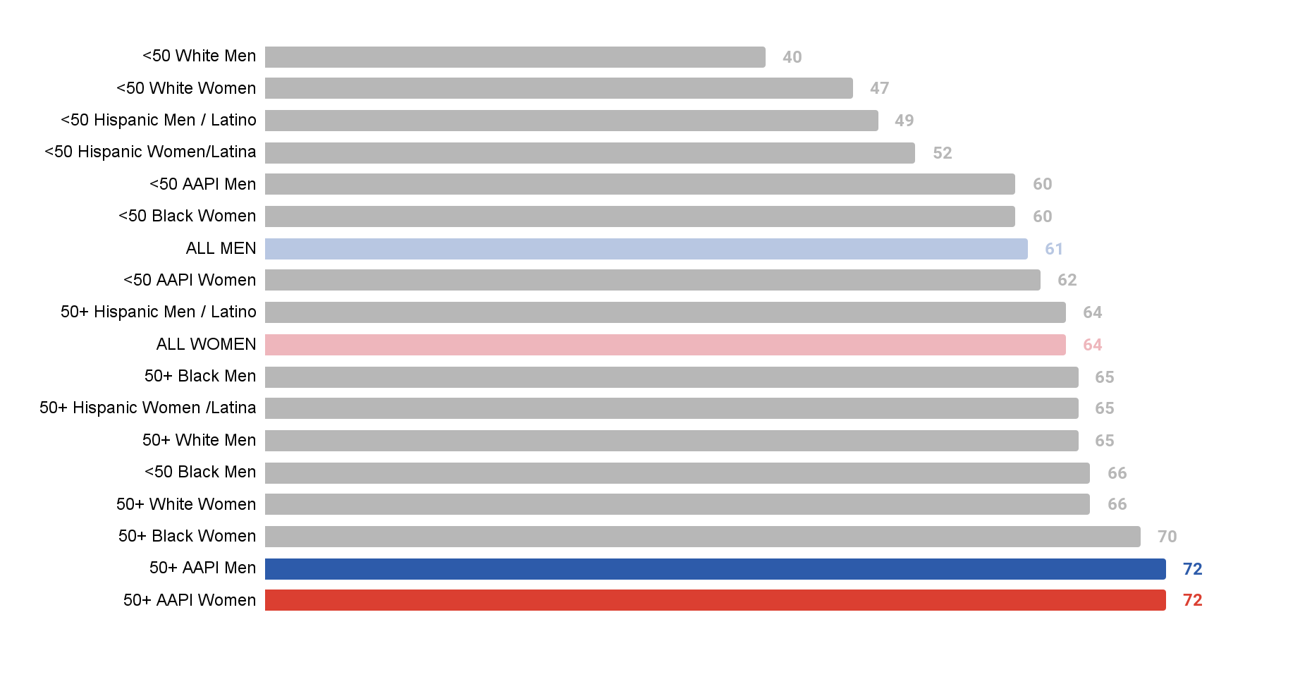
Older AAPI Business Owners Expect Slowest Recovery
Expect at least 6 months before reaching pre-pandemic revenue
% of Respondents
Source: RMS/PPS/USBC/USHCC/National ACE survey, “Looking Ahead: Is Your Business Rebounding from COVID-19?” (April-May 2021)
Q5: When do you expect your business revenue to return to its pre-pandemic level?
Note: All segments represent n>30. Native sample too small to include.

Slide 19
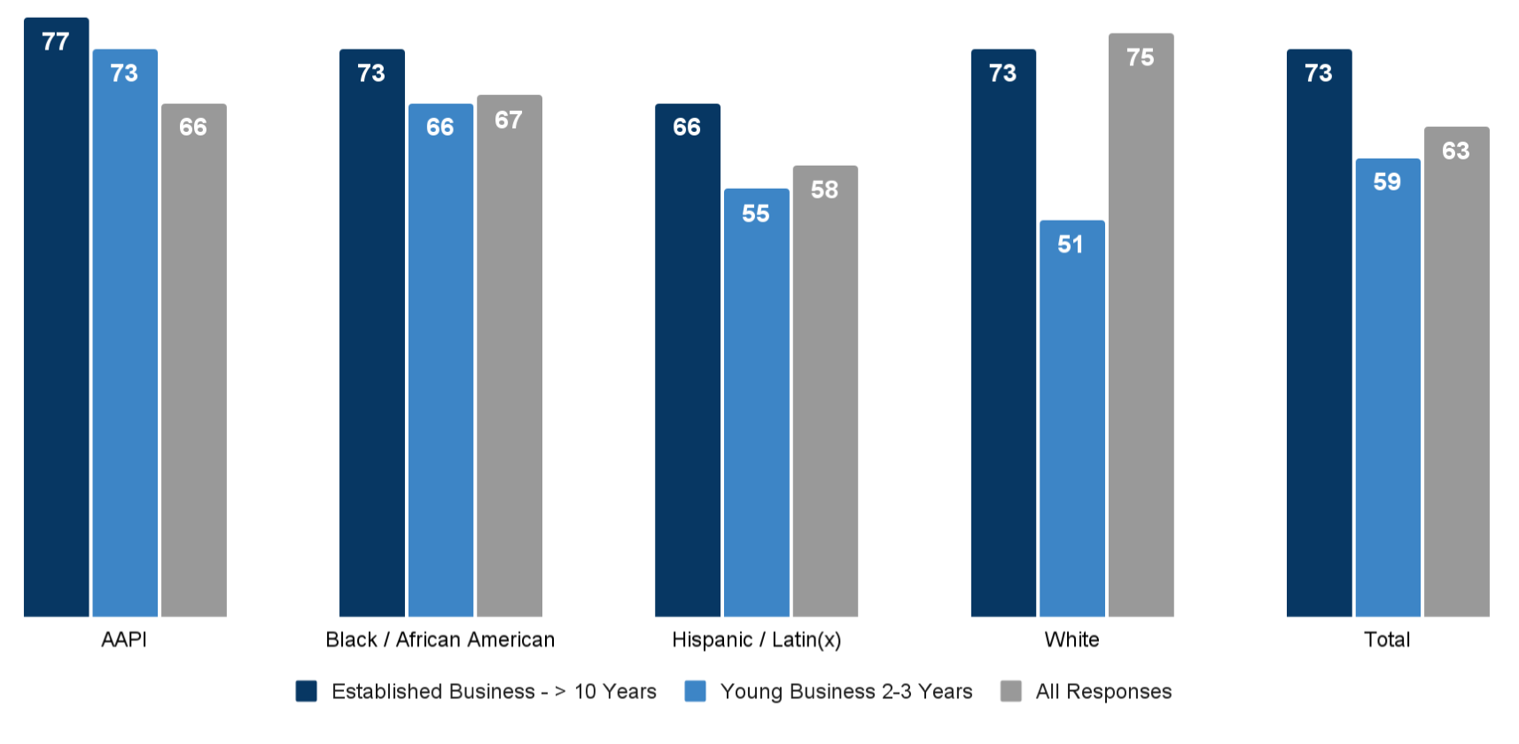
Long-Standing AAPI Businesses Expect Slowest Recovery
Respondents who expect recovery will take at least 6 months, by time in business
Source: RMS/PPS/USBC/USHCC/National ACE survey, “Looking Ahead: Is Your Business Rebounding from COVID-19?” (April-May 2021)
Q5: When do you expect your business revenue to return to its pre-pandemic level?
Q39: How long has your business been in operation?
Note: Totals include Native respondents but sample too small for meaningful subcut analysis

Slide 20
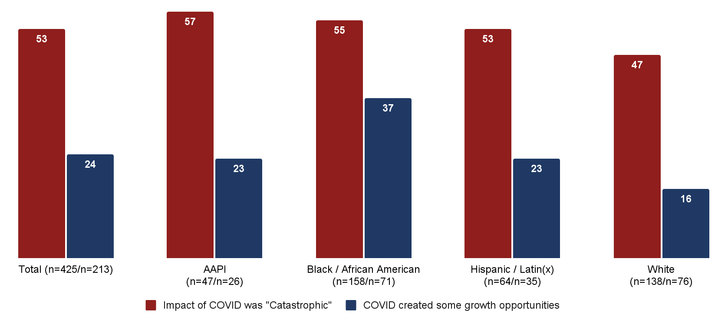
Hardest Hit AAPI Businesses Expect Slowest Recovery
Respondents who expect it will take > 6 months to reach pre-pandemic revenue*
% of Respondents
Source: RMS/PPS/USBC/USHCC/National ACE survey, “Looking Ahead: Is Your Business Rebounding from COVID-19?” (April-May 2021)
Q5: When do you expect your business revenue to return to its pre-pandemic level? ; Q8: Looking back, what was the impact of COVID-19 on your business?
Note: Totals include Native respondents but sample too small for meaningful subcut analysis

Slide 21
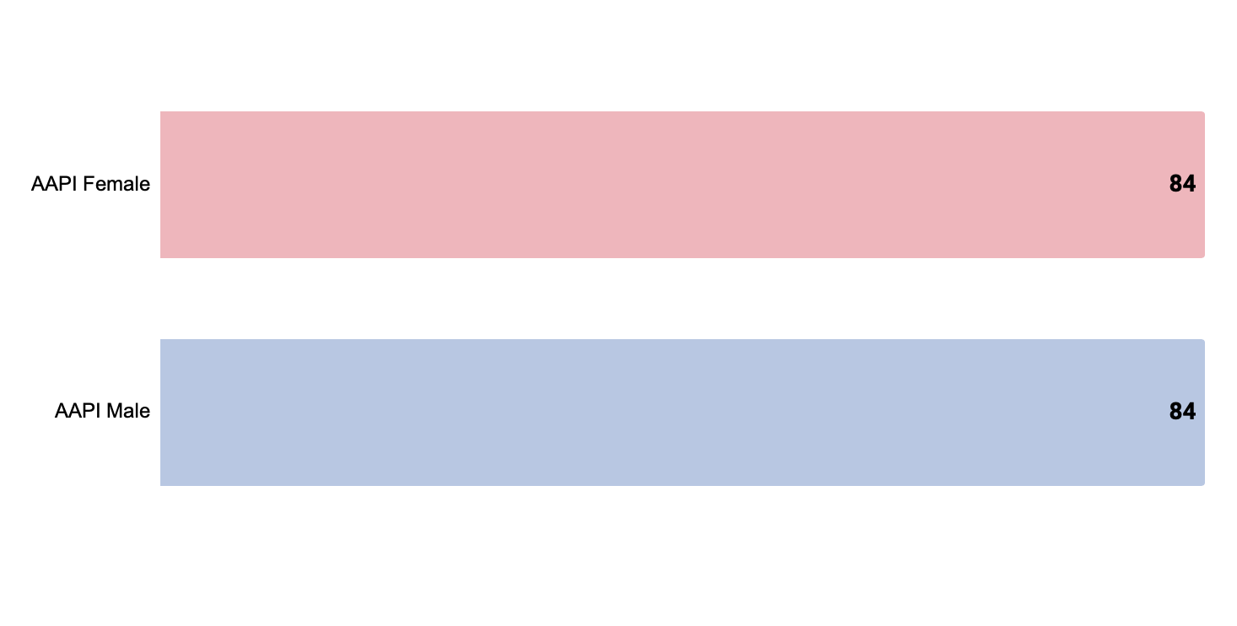
Operational Changes Have Become the “New Normal” for AAPI Small Business Owners
Respondents who Agree that “Changes to business operations in response to the pandemic will become permanent.”
% of Respondents*
Source: RMS/PPS/USBC/USHCC/National ACE survey, “Looking Ahead: Is Your Business Rebounding from COVID-19?” (April-May 2021)
Q3: Tell us the extent to which you agree or disagree with the following statements
“Strongly agree” and “agree” vs “Disagree and Strongly Disagree ;
**Of those who expressed an opinion

Slide 22
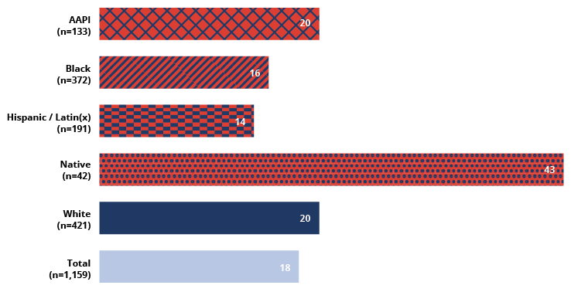
1 in 5 AAPI Businesses Does Not Expect to Survive
“I am confident that my business will make it to the end of the year”
% Disagree*
Source: RMS/PPS/USBC/USHCC/National ACE survey, “Looking Ahead: Is Your Business Rebounding from COVID-19?” (April-May 2021)
Q4: As you reflect on where things stand today, how would you characterize your outlook:
*Of those who expressed an opinion

Slide 23
Bias & Anti-Asian Sentiment
Notes:
Rhett

Slide 24
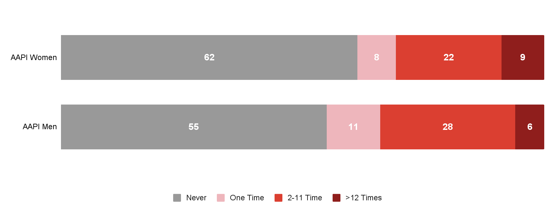
4 in 10 AAPI Small Business Owners Report Having Been Blamed for the COVID-19 Pandemic
Respondents who report experiencing Blame for COVID-19 Pandemic
% of respondents
Source: RMS/PPS/USBC/USHCC/National ACE survey, “Looking Ahead: Is Your Business Rebounding from COVID-19?” (April-May 2021)
Q32: Reflecting on the past 12 months, have you experienced any of the following because you are of Asian or Pacific Island origin?

Slide 25
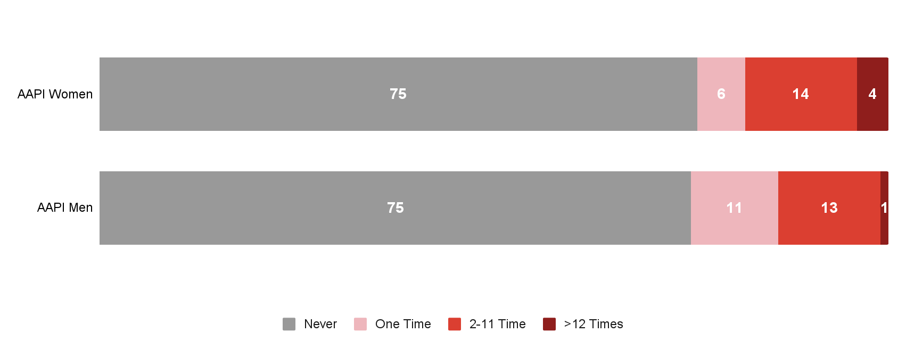
One in Four AAPI Small Business Owners Experienced Vandalism or Threats at Their Businesses
Respondents who report experiencing vandalism or threats at their places of business
% of respondents
Source: RMS/PPS/USBC/USHCC/National ACE survey, “Looking Ahead: Is Your Business Rebounding from COVID-19?” (April-May 2021)
Q32: Reflecting on the past 12 months, have you experienced any of the following because you are of Asian or Pacific Island origin?

Slide 26
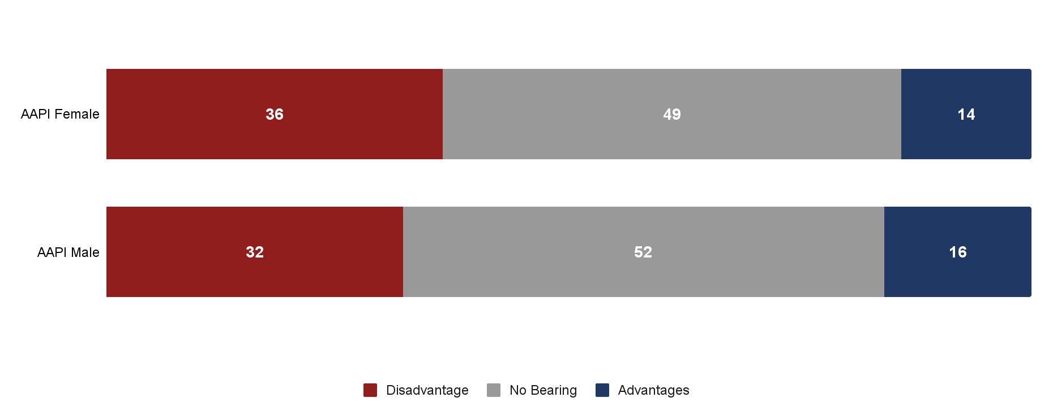
About One Third of AAPI Small Business Owners Say they are Disadvantaged Due to their Race
Does race or ethnicity affect opportunities available to the business?
% of respondents
Source: RMS/PPS/USBC/USHCC/National ACE survey, “Looking Ahead: Is Your Business Rebounding from COVID-19?” (April-May 2021)
Q11: Reflect on the last 12 months and where your business is today. Do you think your race or ethnicity affects opportunities available to your business and/or your business performance?

Slide 27
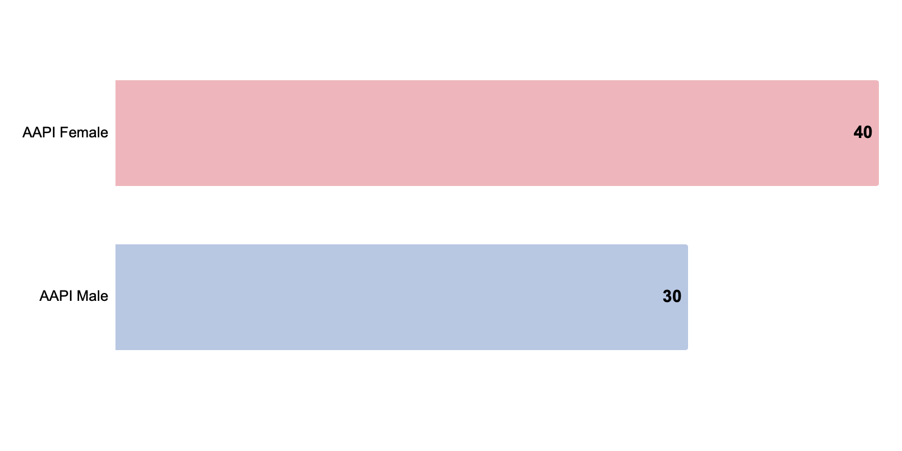
AAPI Women Business Owners More Likely to Experience Unfair Treatment Due to Race or Ethnicity
Respondents who report their businesses were treated unfairly because of their race or ethnicity
% of respondents*
Source: RMS/PPS/USBC/USHCC/National ACE survey, “Looking Ahead: Is Your Business Rebounding from COVID-19?” (April-May 2021)
Q9 Was there a time in the last twelve months when you felt you or your business was treated unfairly because of your racial or ethnic background?

Slide 28
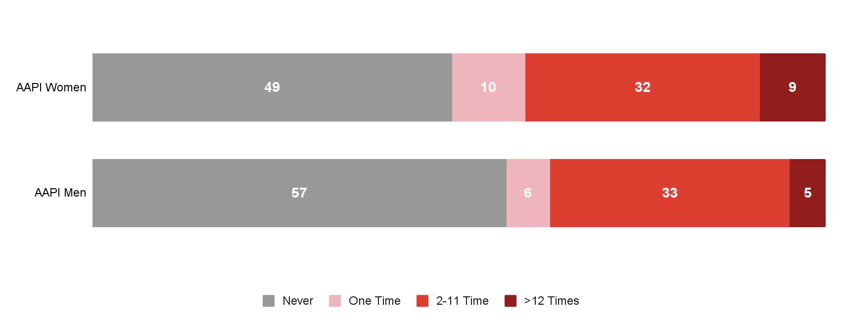
More than Half of AAPI Women Small Business Owners Treated with Disrespect
Respondents who report having been treated with disrespect
% of respondents
Source: RMS/PPS/USBC/USHCC/National ACE survey, “Looking Ahead: Is Your Business Rebounding from COVID-19?” (April-May 2021)
Q32: Reflecting on the past 12 months, have you experienced any of the following because you are of Asian or Pacific Island origin?

Slide 29
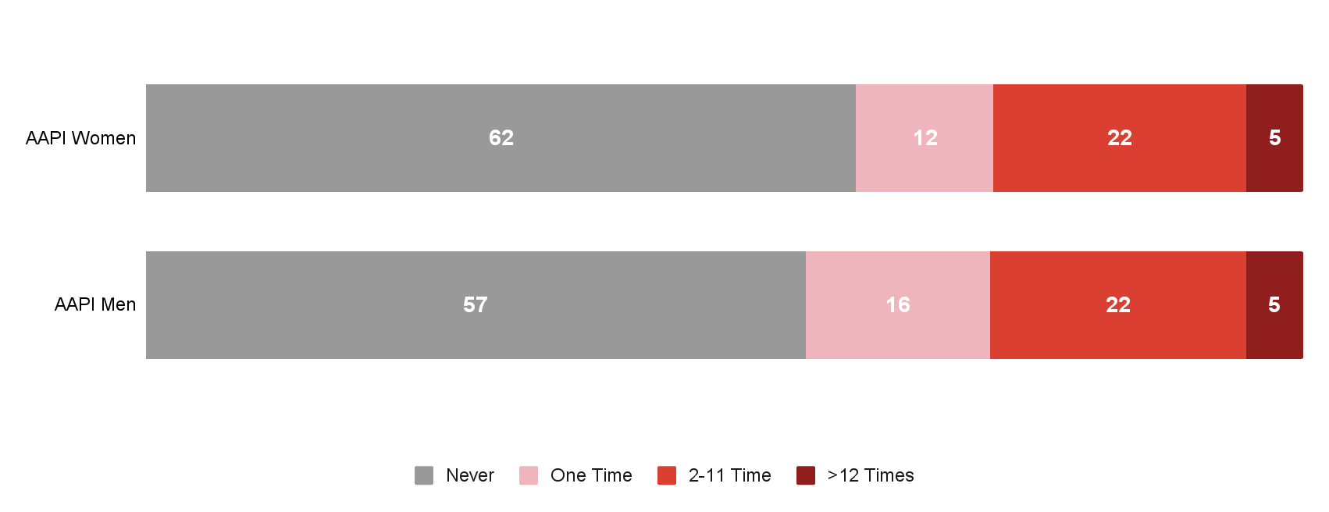
More than 40% of AAPI Small Business Owners Were Treated Unfairly at Restaurants or Stores
Respondents who report having been treated unfairly at restaurants or stores
% of respondents
Source: RMS/PPS/USBC/USHCC/National ACE survey, “Looking Ahead: Is Your Business Rebounding from COVID-19?” (April-May 2021)
Q32: Reflecting on the past 12 months, have you experienced any of the following because you are of Asian or Pacific Island origin?

Slide 30
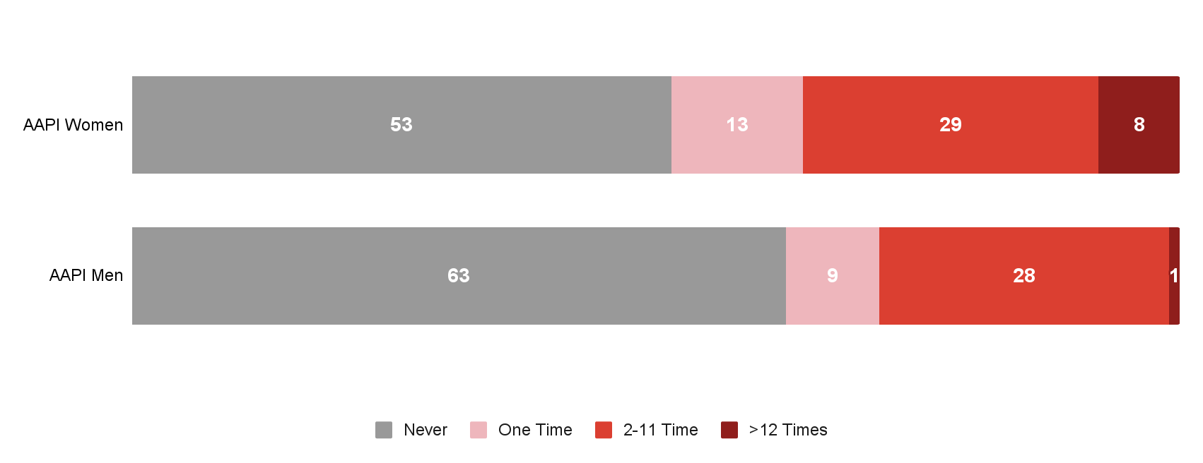
AAPI Women Business Owners Frequently Treated as if they were Not Smart
Respondents who report having been treated as if they were not smart
% of respondents
Source: RMS/PPS/USBC/USHCC/National ACE survey, “Looking Ahead: Is Your Business Rebounding from COVID-19?” (April-May 2021)
Q32: Reflecting on the past 12 months, have you experienced any of the following because you are of Asian or Pacific Island origin?

Slide 31
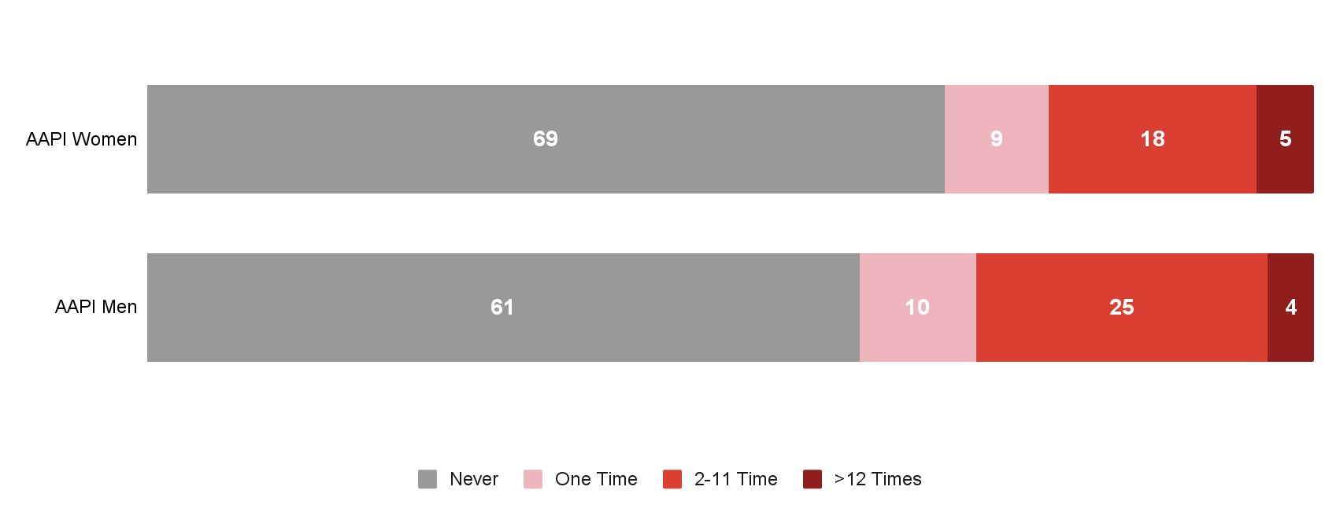
>30% of Four AAPI Small Business Owners Were Criticized for an Accent or Manner of Speech
Respondents who report having been criticized for an accent or manner of speech
% of respondents
Source: RMS/PPS/USBC/USHCC/National ACE survey, “Looking Ahead: Is Your Business Rebounding from COVID-19?” (April-May 2021)
Q32: Reflecting on the past 12 months, have you experienced any of the following because you are of Asian or Pacific Island origin?

Slide 32
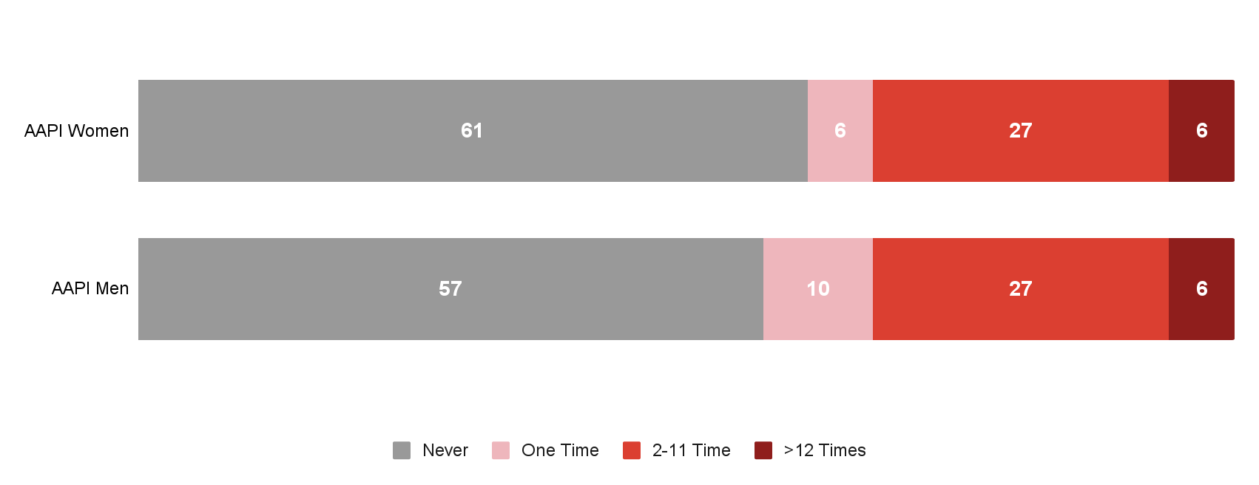
~40% of AAPI Business Owners Report Being Feared by Others
Respondents who report having been treated as if they were feared by others
% of respondents
Source: RMS/PPS/USBC/USHCC/National ACE survey, “Looking Ahead: Is Your Business Rebounding from COVID-19?” (April-May 2021)
Q32: Reflecting on the past 12 months, have you experienced any of the following because you are of Asian or Pacific Island origin?

Slide 33
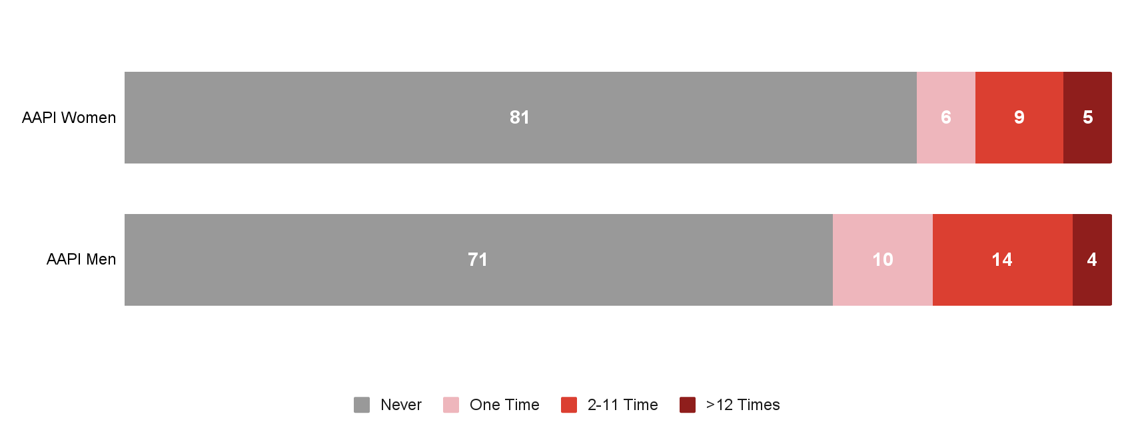
>20% of AAPI Business Owners Report Being Accused of Dishonesty
Respondents who report having been accused of dishonesty
% of respondents
Source: RMS/PPS/USBC/USHCC/National ACE survey, “Looking Ahead: Is Your Business Rebounding from COVID-19?” (April-May 2021)
Q32: Reflecting on the past 12 months, have you experienced any of the following because you are of Asian or Pacific Island origin?

Slide 34
Relief
Notes:
Rhett

Slide 35
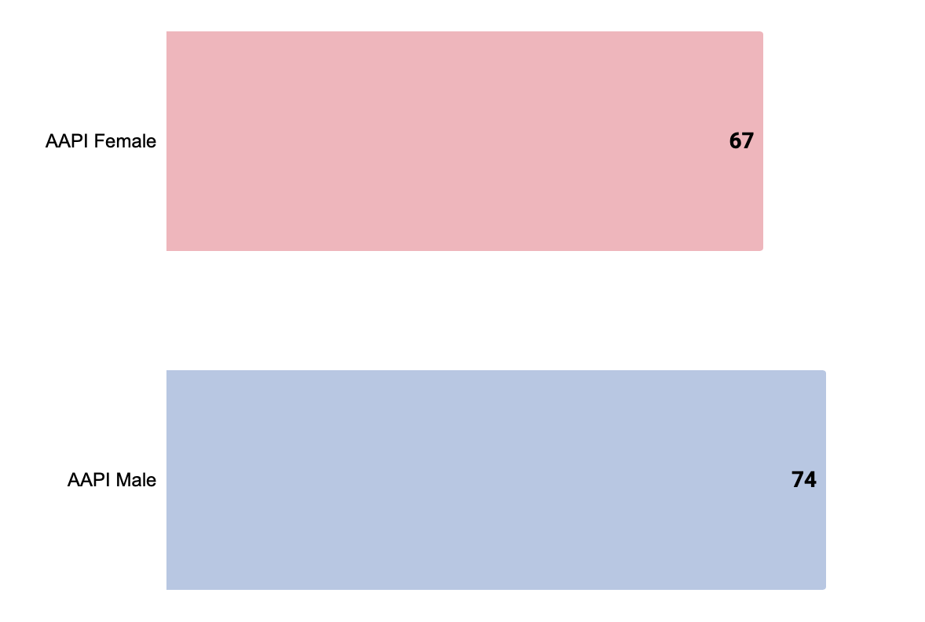
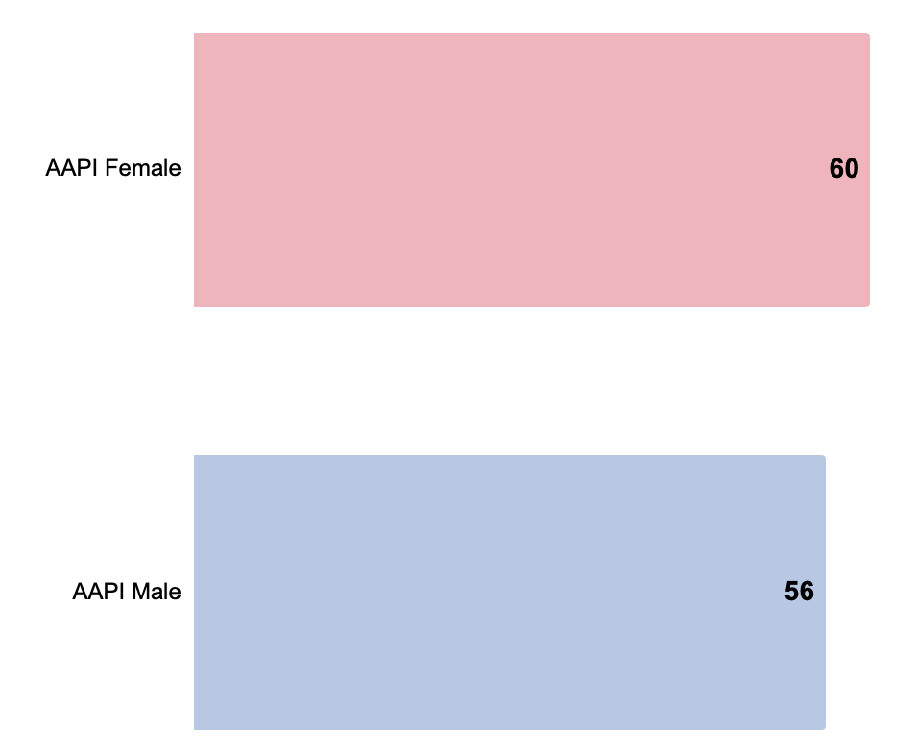
Most AAPI Small Business Owners Applied for Federal Relief
Application Rates
% of respondents*
PPP
EIDL
Source: RMS/PPS/USBC/USHCC/National ACE survey, “Looking Ahead: Is Your Business Rebounding from COVID-19?” (April-May 2021)
Q12: Have you applied for any of the following Federal small business relief programs?

Slide 36
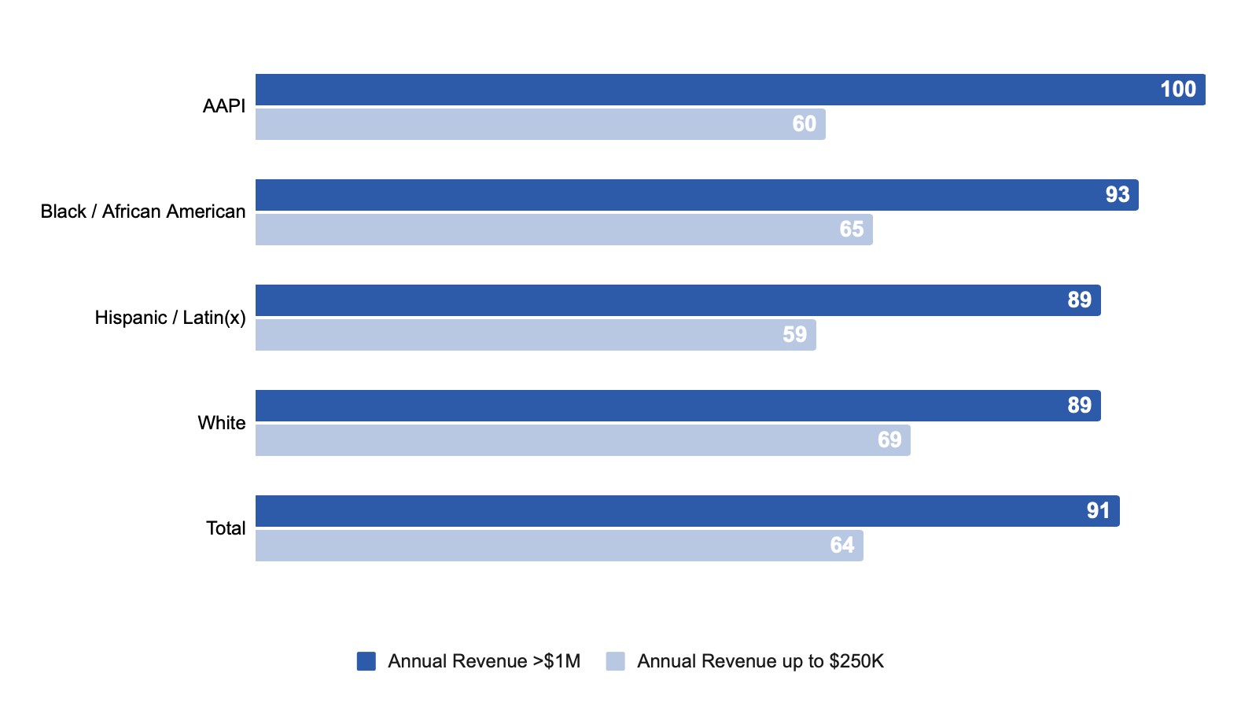
Gap in PPP Application Rate for Very Small AAPI Businesses
PPP Application Rates
Source: RMS/PPS/USBC/USHCC/National ACE survey, “Looking Ahead: Is Your Business Rebounding from COVID-19?” (April-May 2021)
Q12: Have you applied for any of the following Federal small business relief programs?
Native sample too small to breakout
*Self-reported for 2020

Slide 37
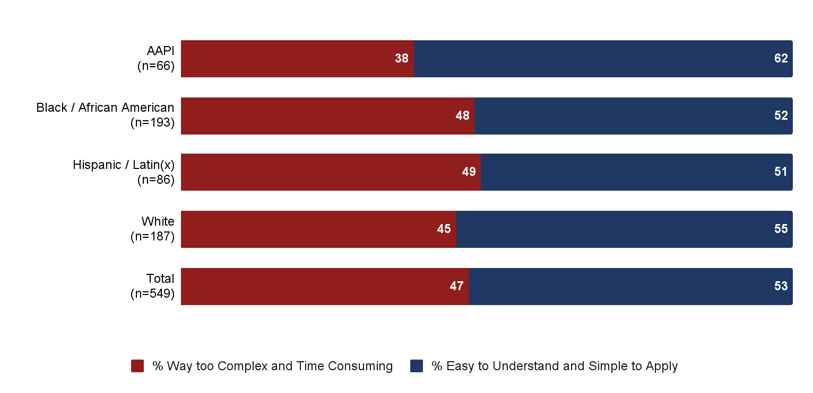
AAPI Business Owners Reported Most Positive PPP Application Experience
Experience Applying for PPP
% of respondents*
Source: RMS/PPS/USBC/USHCC/National ACE survey, “Looking Ahead: Is Your Business Rebounding from COVID-19?” (April-May 2021)
Q13: How would you characterize your experience applying for small business relief from the Federal government?
*Native sample too small to break out

Slide 38
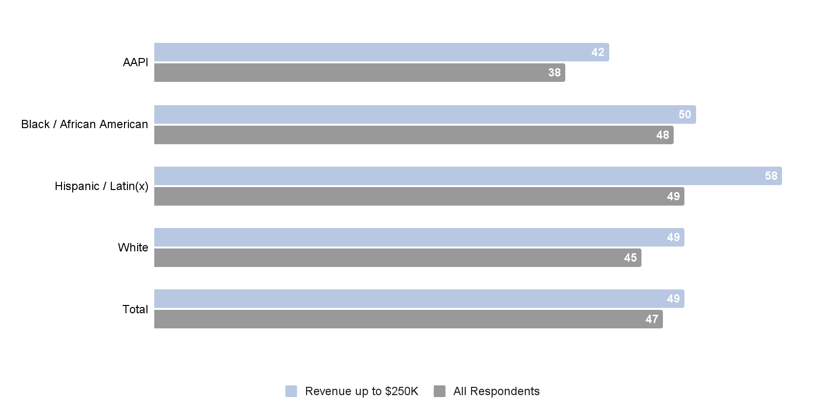
More than 2 in 5 Very Small AAPI Businesses Struggled with the Application Process
Found the application process “Way too complex and time consuming”
% of Respondents
Source: RMS/PPS/USBC/USHCC/National ACE survey, “Looking Ahead: Is Your Business Rebounding from COVID-19?” (April-May 2021)
Q13: How would you characterize your experience applying for small business relief from the Federal government?
*Native sample too small to break out

Slide 39
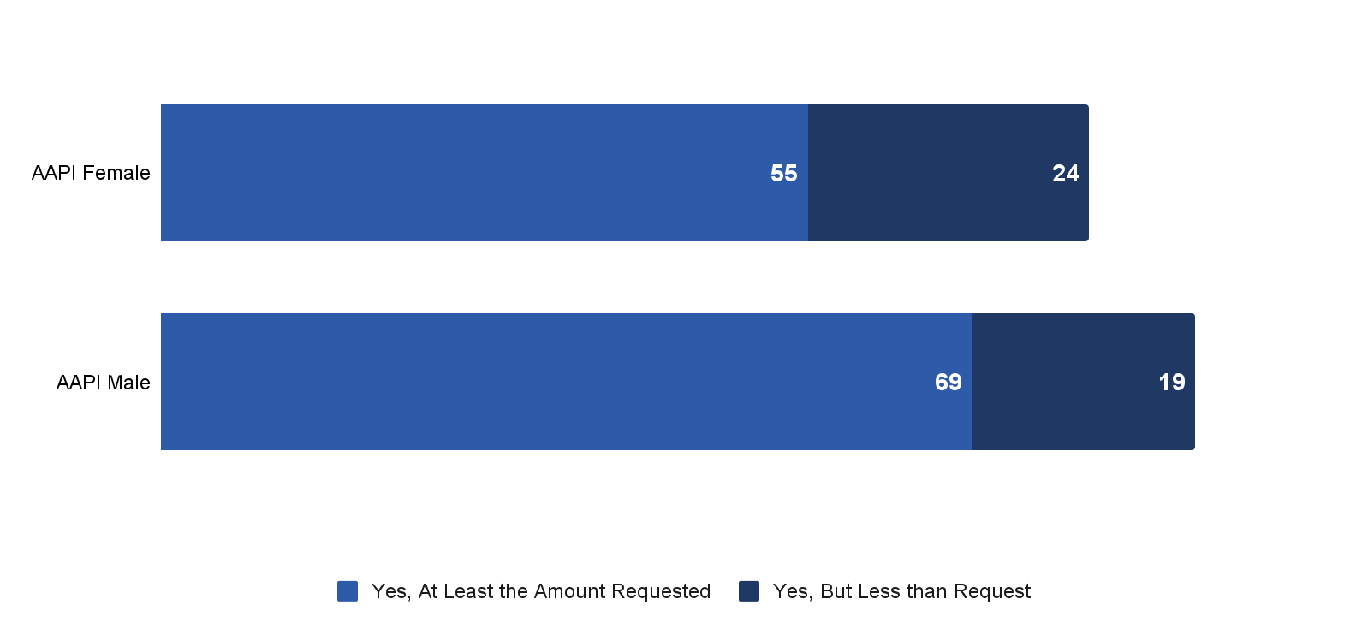
Majority of AAPI Applications for PPP Funded; Men More Successful than Women
PPP Funding Rates
% of respondents*
PPP Funding Rate
79%
88%
Source: RMS/PPS/USBC/USHCC/National ACE survey, “Looking Ahead: Is Your Business Rebounding from COVID-19?” (April-May 2021)
Q17: Did you receive funding from any of the following small business relief programs?

Slide 40
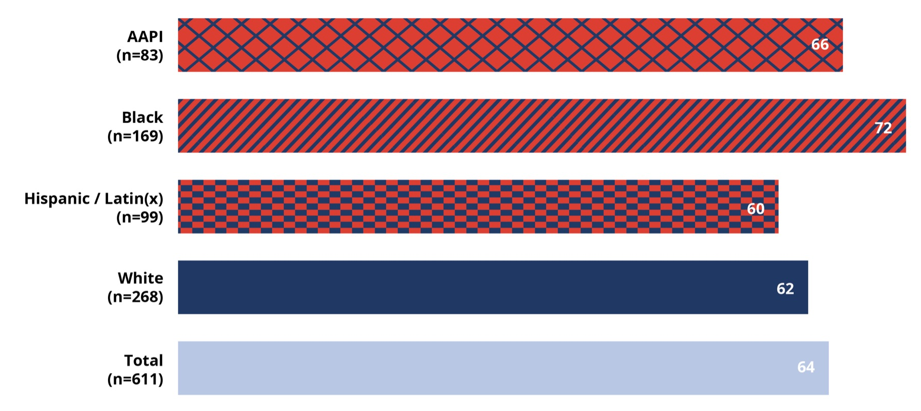
PPP was Critical Lifeline for AAPI Recipients
“How would you characterize the impact on your business of the PPP funding you received?”
% of respondents who selected “Critical to keep the business afloat”
Source: RMS/PPS/USBC/USHCC/National ACE survey, “Looking Ahead: Is Your Business Rebounding from COVID-19?” (April-May 2021)
Q18: For each relief program from which you received funding, how would you characterize the impact on your business?
Native sample too small for confidence

Slide 41
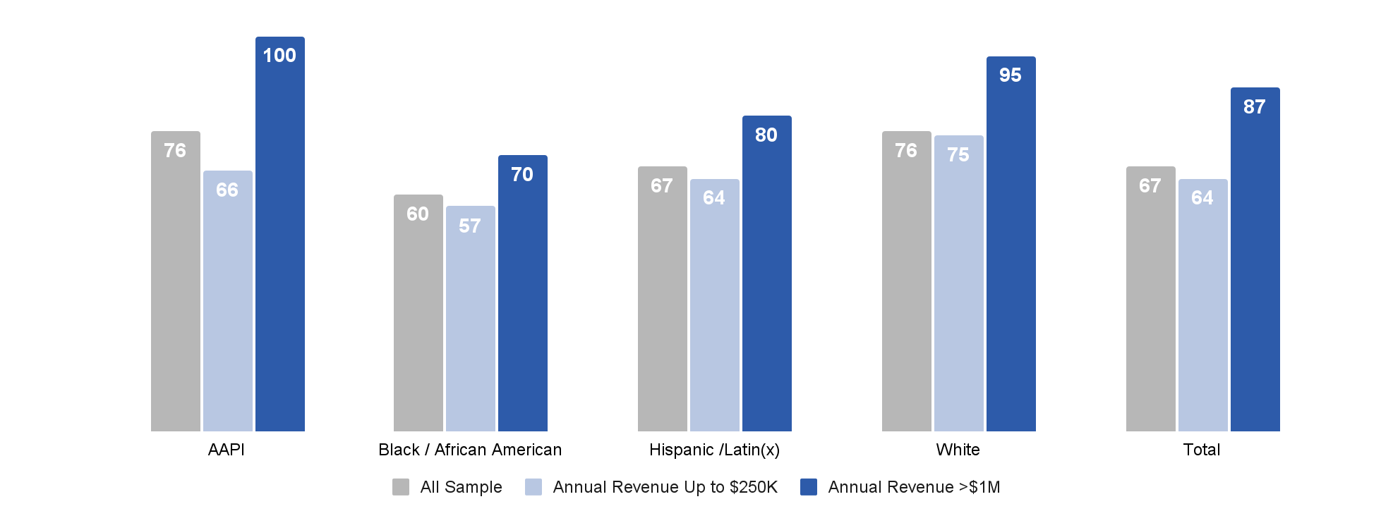
Largest AAPI Business Were Most Successful with PPP Funding
PPP Funding Rates
% of respondents*
Source: RMS/PPS/USBC/USHCC/National ACE survey, “Looking Ahead: Is Your Business Rebounding from COVID-19?” (April-May 2021)
Q17: Did you receive funding from any of the following small business relief programs?
*Native sample too small to break out

Slide 42
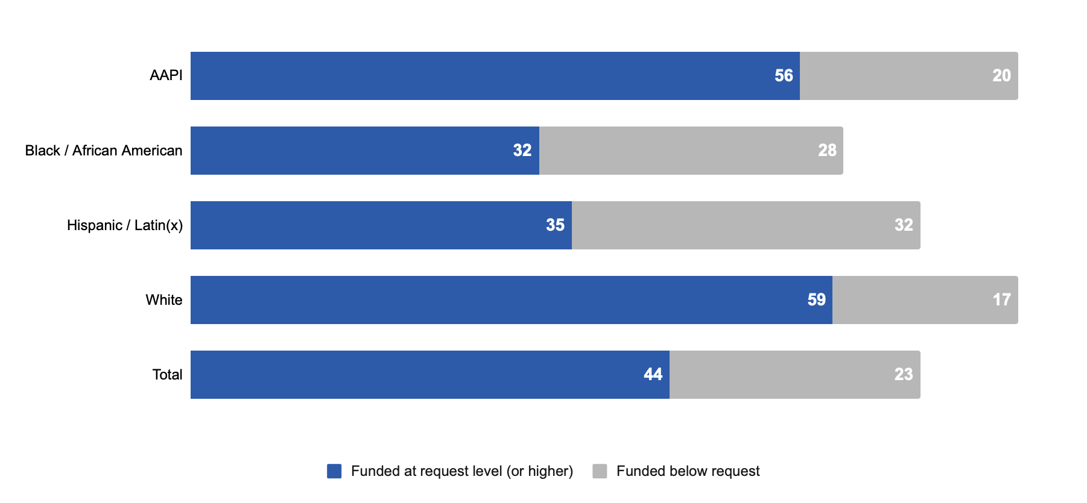
AAPI Business Owners Reported Highest Funding Rate for PPP
PPP Funding Rates
% of respondents*
PPP Funding Rate
76%
60%
67%
76%
67%
Source: RMS/PPS/USBC/USHCC/National ACE survey, “Looking Ahead: Is Your Business Rebounding from COVID-19?” (April-May 2021)
Q17: Did you receive funding from any of the following small business relief programs?
Note: Native sample too small to break out

Slide 43
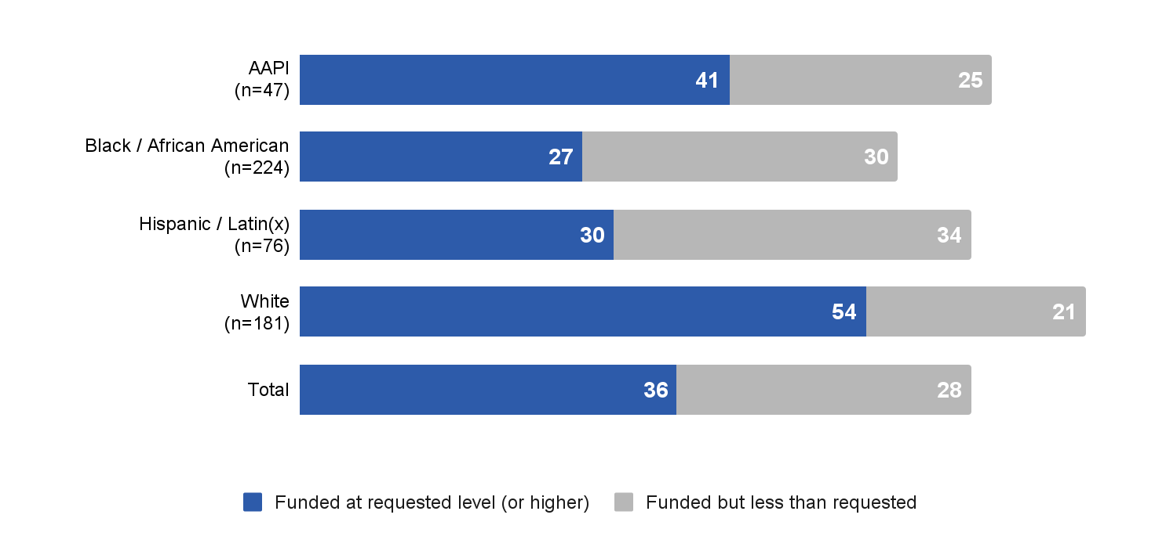
Very Small AAPI Businesses Received PPP Funding at Lower Rate than White Peers
PPP “Funding Rate*” for Businesses with <$250K annual revenue
66%
57%
64%
75%
64%
Source: RMS/PPS/USBC/USHCC/National ACE survey, “Looking Ahead: Is Your Business Rebounding from COVID-19?” (April-May 2021)
Q17: Did you receive funding from any of the following small business relief programs?
Qx: What was your 2020 annual revenue?
Native sample too small to break out

Slide 44
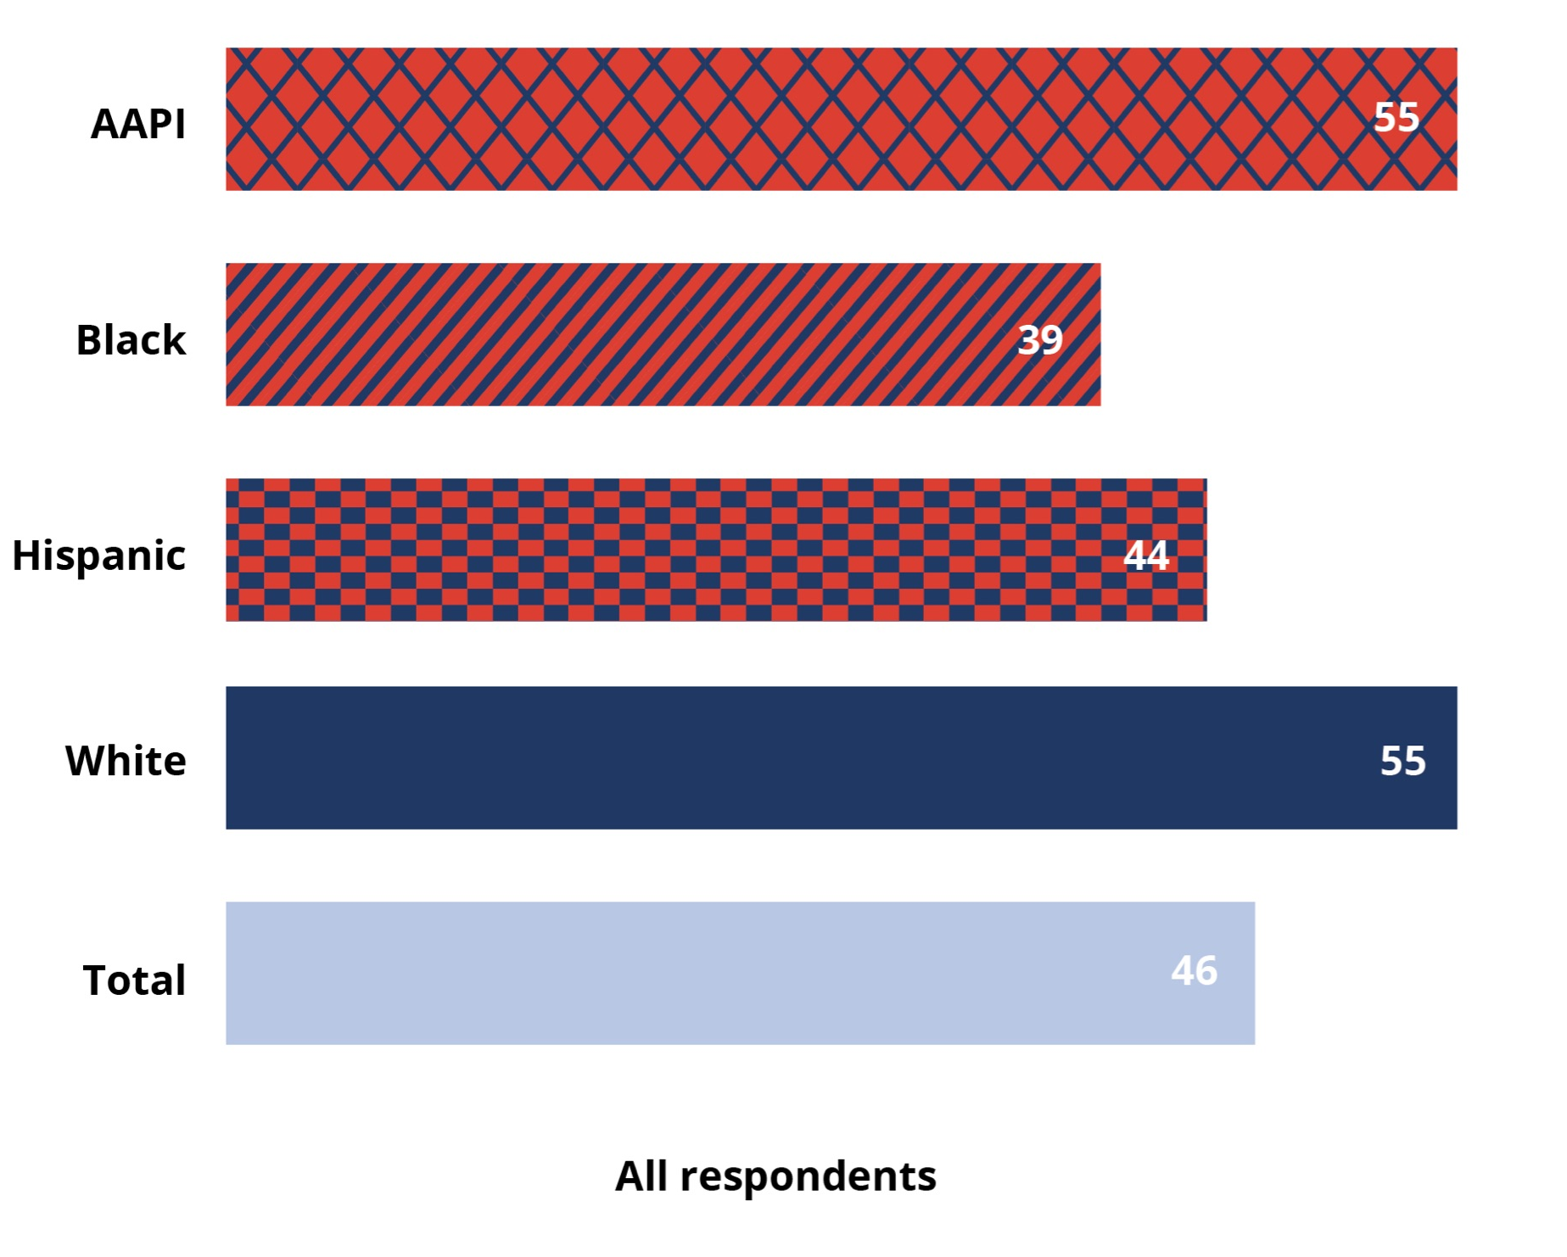
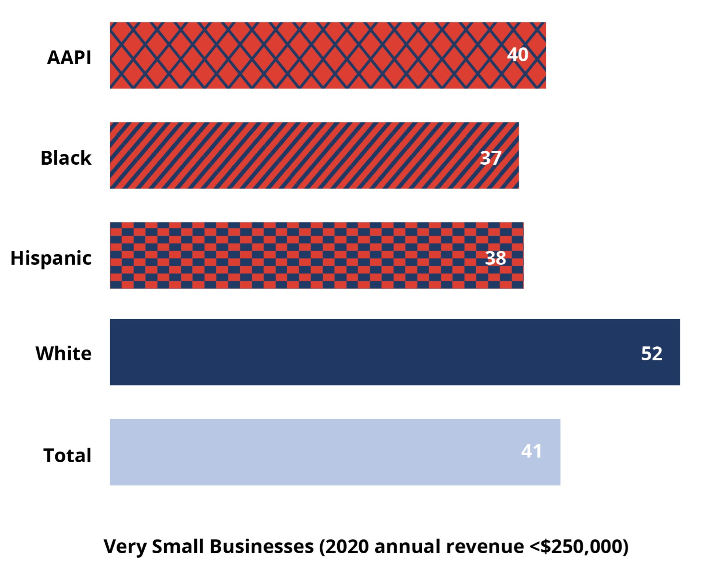
AAPI Businesses Reported Highest PPP Success Rates But Smallest Businesses at Rough Parity
PPP Success Rates (Success rate = Application rate x Funding rate)
Source: RMS/PPS/USBC/USHCC/National ACE survey, “Looking Ahead: Is Your Business Rebounding from COVID-19?” (April-May 2021)
Q12: Have you applied for any of the following Federal small business relief programs?
Q17: Did you receive funding from any of the following small business relief programs?
*Self-reported for 2020

Slide 45
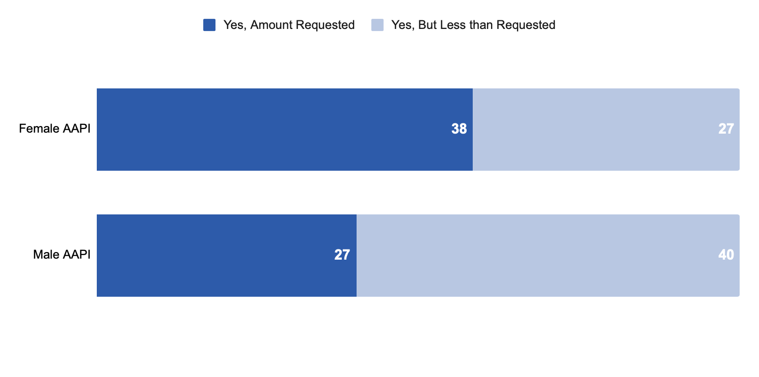
About 2 in 3 AAPI Applications for EIDL Funded
EIDL Funding Rates
% of respondents
EIDL Funding Rate
65%
67%
Source: RMS/PPS/USBC/USHCC/National ACE survey, “Looking Ahead: Is Your Business Rebounding from COVID-19?” (April-May 2021)
Q17: Did you receive funding from any of the following small business relief programs?

Slide 46
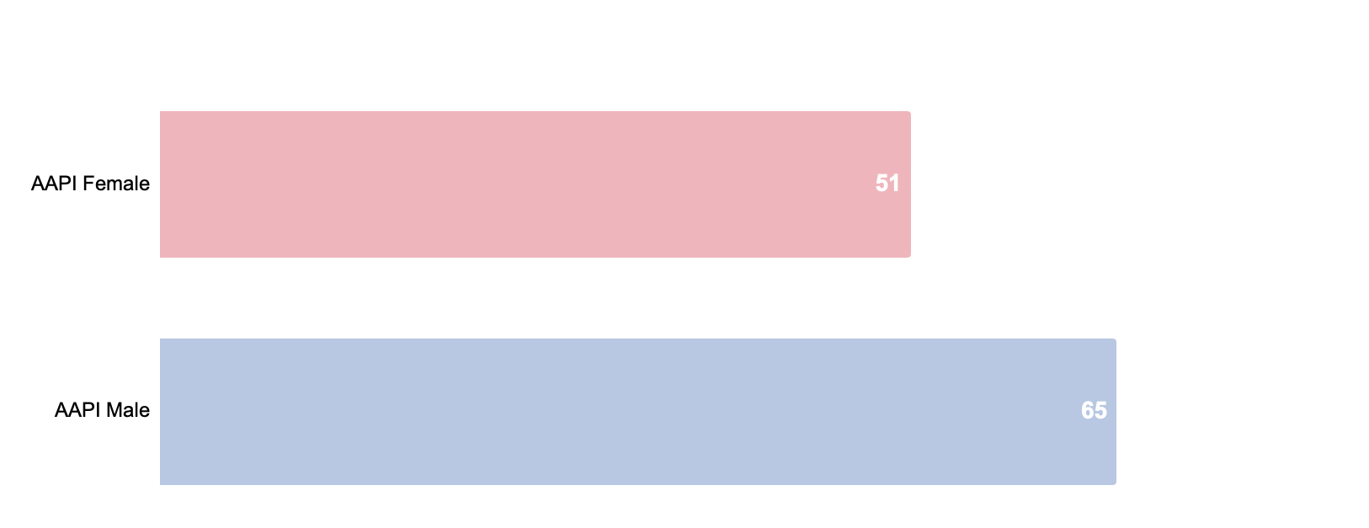
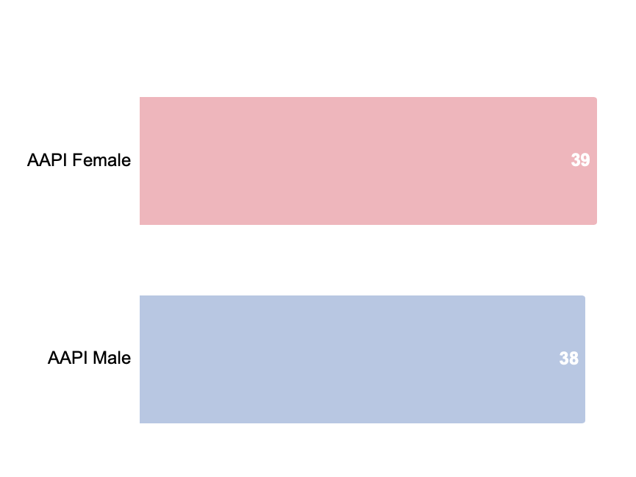
AAPI Men Experienced Higher PPP Success Rates; EIDL at Rough Parity
Success Rates (Success rate = Application rate x Funding rate)
PPP
EIDL
Source: RMS/PPS/USBC/USHCC/National ACE survey, “Looking Ahead: Is Your Business Rebounding from COVID-19?” (April-May 2021)
Q12: Have you applied for any of the following Federal small business relief programs?
Q17: Did you receive funding from any of the following small business relief programs?
*Self-reported for 2020

Slide 47
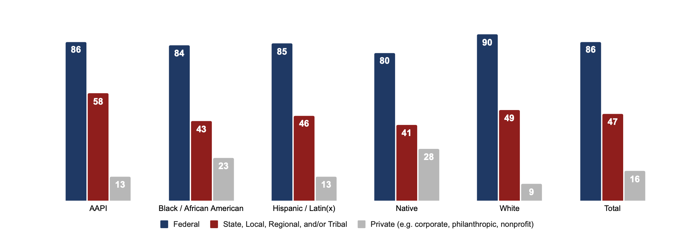
AAPI Business Owners More Likely to have Sought Relief from State and Local Sources
Have You Applied for Relief from….
% of Respondents who sought relief
Source: RMS/PPS/USBC/USHCC/National ACE survey, “Looking Ahead: Is Your Business Rebounding from COVID-19?” (April-May 2021)
Q12:Have you applied for any of the following Federal small business relief programs?
Q14: Have you applied for relief from your state, local, regional or tribal authority?
Q16: Have you applied for relief for your small business from any of the following programs?

Slide 48
Issues and Sentiment
Notes:
Rhett

Slide 49
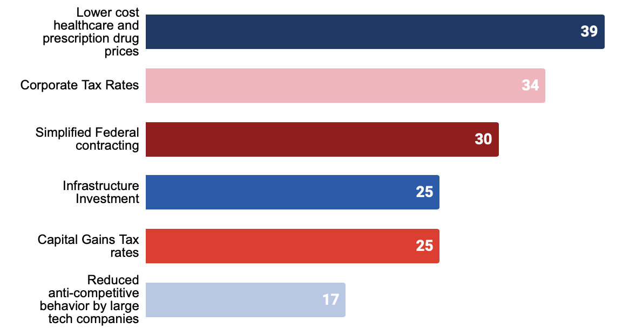
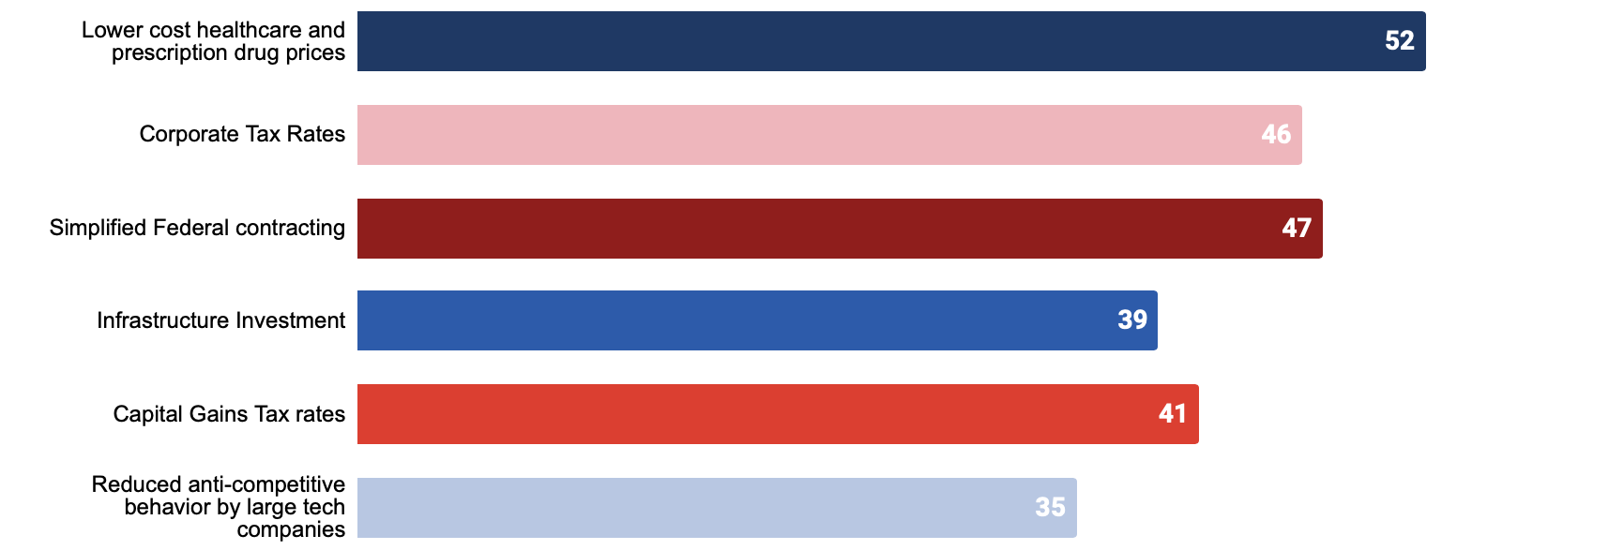
AAPI Business Owners Prioritize Lower Healthcare Costs, Corporate Tax Rates and Simplified Federal Contracting
Intensity of Support
% of Respondents
Absolute Support
% of Respondents
Source: RMS/PPS/USBC/USHCC/National ACE survey, “Looking Ahead: Is Your Business Rebounding from COVID-19?” (April-May 2021)
Q19:Please describe the importance to you or your business, if any, of the following list of Federal policy issues
Intensity = % Extremely Important - % No Relevance
Absolute = % Extremely important

Slide 50
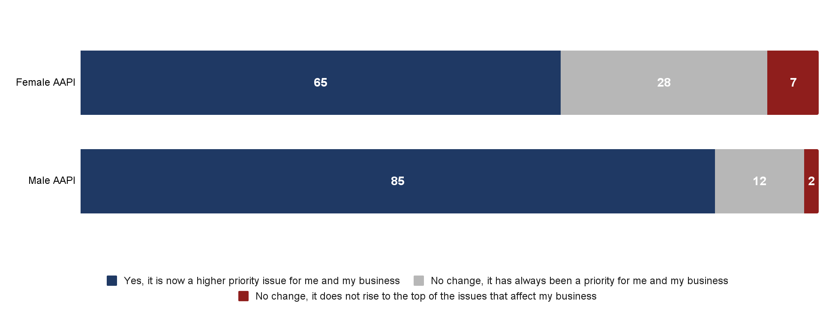
Pandemic has Elevated Importance of Public Health for AAPI Small Business Owners
Has the COVID-19 pandemic changed the way you think about the practice of preventing disease and promoting good health (e.g. public health)?
% of respondents
Source: RMS/PPS/USBC/USHCC/National ACE survey, “Looking Ahead: Is Your Business Rebounding from COVID-19?” (April-May 2021)
Q27: Has the COVID-19 pandemic changed the way you think about the practice of preventing disease and promoting good health (e.g. public health)?

Slide 51
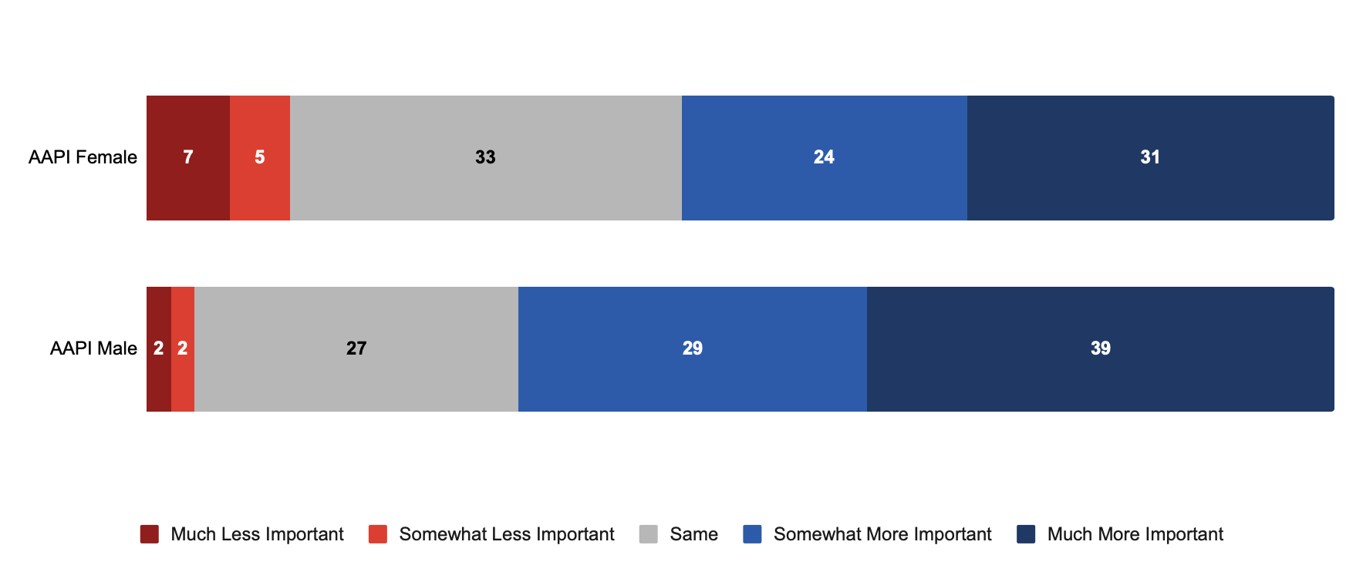
Pandemic has Elevated Importance of Health Insurance for AAPI Small Business Owners...
How has the pandemic affected your views on the importance of health insurance?
% of respondents
Source: RMS/PPS/USBC/USHCC/National ACE survey, “Looking Ahead: Is Your Business Rebounding from COVID-19?” (April-May 2021)
Q28: How has the pandemic affected your views on the importance of health insurance?

Slide 52
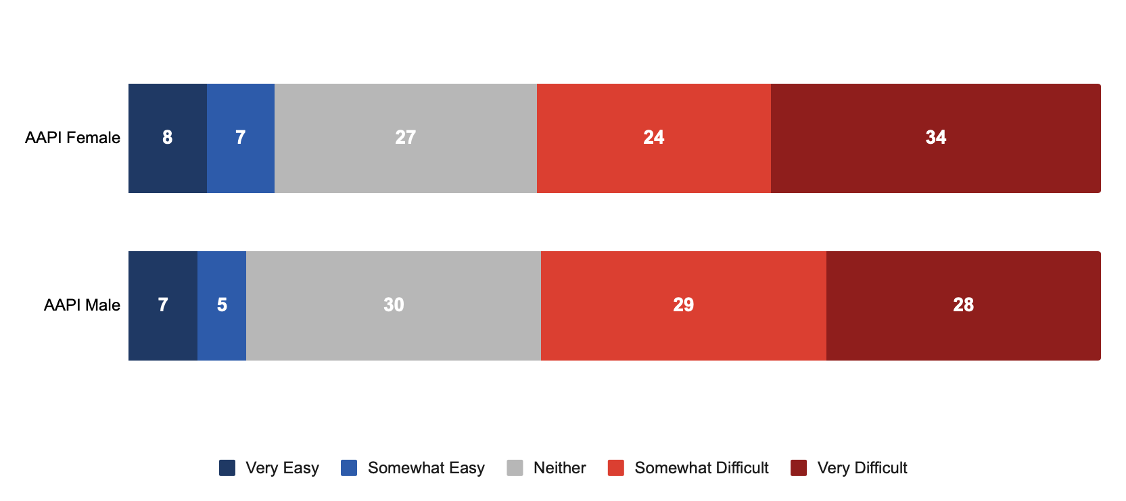
...But Most AAPI Business Owners Report Difficulty in Finding Affordable Health Insurance Coverage
Thinking about your business, how easy or difficult is it for you to find health insurance coverage that you can afford?
% of respondents
Source: RMS/PPS/USBC/USHCC/National ACE survey, “Looking Ahead: Is Your Business Rebounding from COVID-19?” (April-May 2021)
Q29: Thinking about your business, how easy or difficult is it for you to find health insurance coverage that you can afford?

